Slide 1
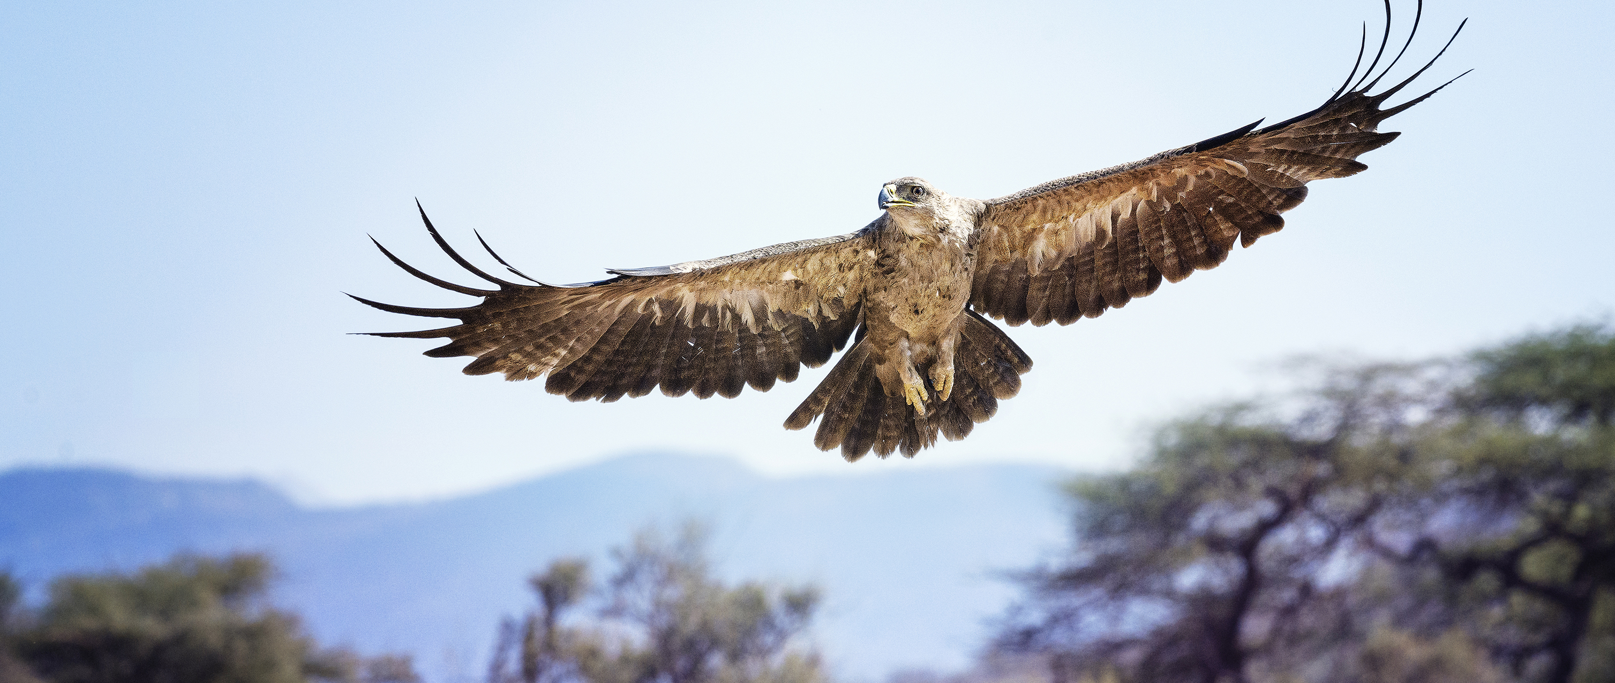
ASD-N Annual First Nation Education Report
2021-2022
Prepared by: ASD-N First Nation Education Team

Slide 2
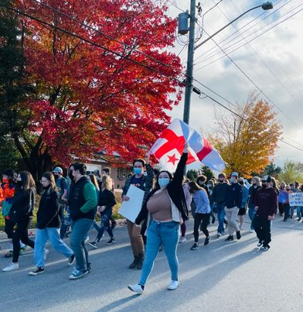
Overview
Professional Learning
Enhancement Agreement
DWF Legacy District for Reconciliation Partnership
Truth and Reconciliation Week
Elders in Schools
Mawi'omi's (Pow Wow's)
Blanket Exercises
Am"bear"isters
Partnerships
Tell Them From me
Challenges & Areas For Growth

Slide 3
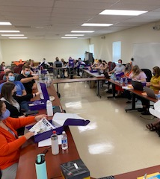
Professional Learning
2 paid professional learning opportunities (February/March 2022)
  Deepened Understanding of Mi'kmaq Culture (16 participants)
  Elders in Schools (8 participants)
2 sessions of voluntary professional learning offered at Bathurst High School for Parkwood Elementary School, Terry Fox School, Superior Middle School, and Bathurst High School staff
  Deepened Understanding of Mi'kmaq Culture
1 school initiated full-staff session at Miramichi Rural School
  Deepened Understanding of Mi'kmaq Culture

Slide 4
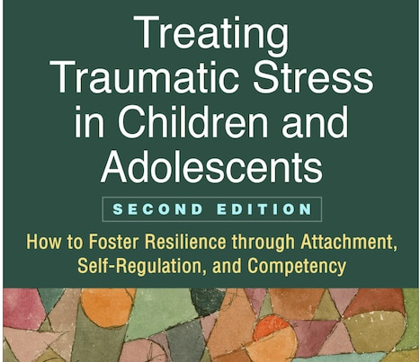
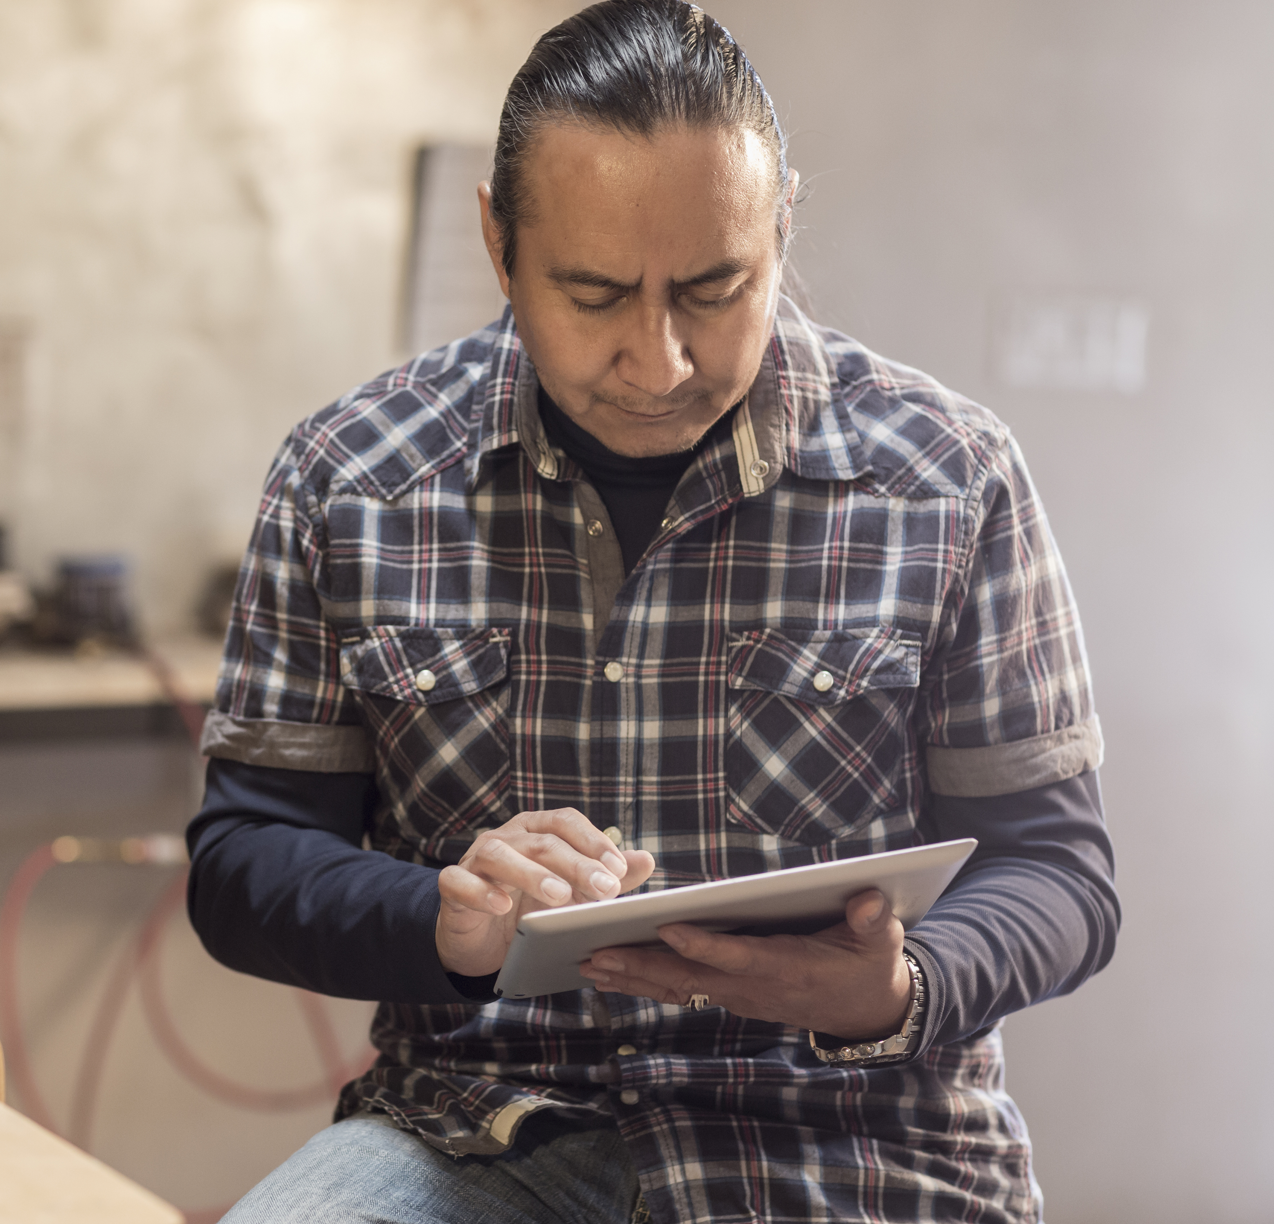
ARC Training
Over 100 ASD-N staff and enhancement employees received Attachment, Regulation and Competency training
12 credit hour certificate course facilitated asynchronously by Dr. Margaret Blaustein.
ASD-N will be offering this course again in 2022-2023

Slide 5

Enhanced First Nation Education Programs & Services Agreement
ASD-N and First Nation Communities have continued to meet as required by the agreement.
Positive growth in academics, school environment and relationships continue in First Nation Education

Slide 6
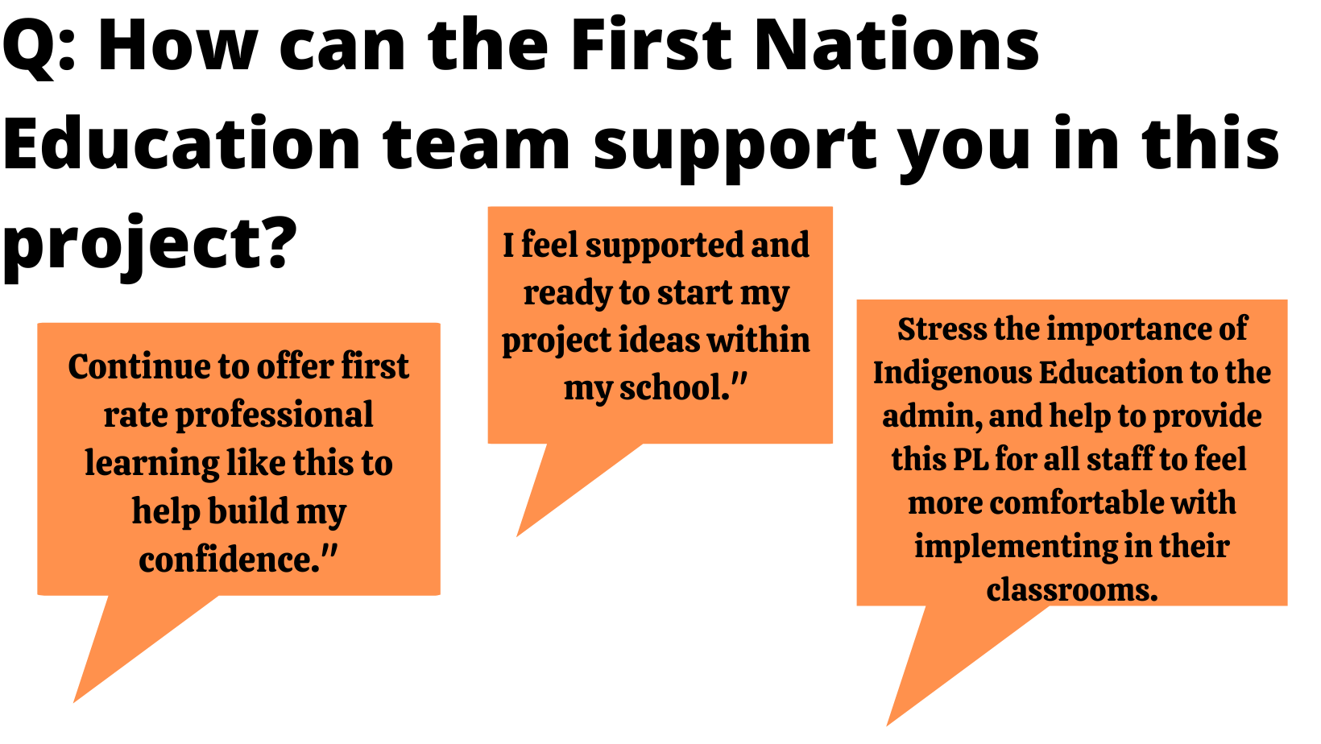
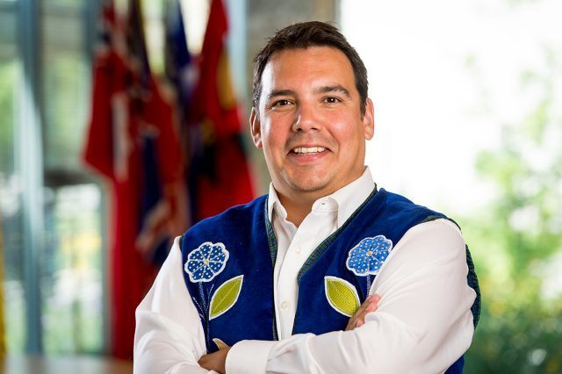
DWF Legacy District for Reconciliation
Supported by the Downey Wenjack Fund, one or more Champions were identified at each school in ASD-N
Kickoff to the year - two days of professional learning for all Champions
  Day I: Welcome, resource distribution, goal setting
  Day II: Climbing the Mountain: Educating for Reconciliation in Canada with Dr. Niigaan Sinclair

Slide 7
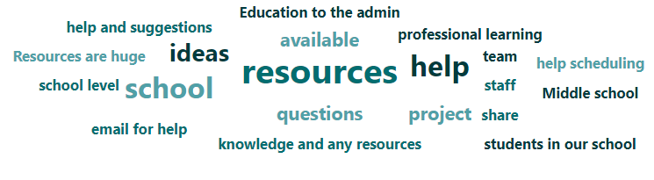
DWF Partnership – Champion & School Support
In response to Champion feedback, the following supports were made available:
  Two release days per school champion
  $500 Do Something grants to each school to implement projects
  Resource delivery to schools through champions to empower their leadership among staff and to ensure they are familiar with available resources

Slide 8
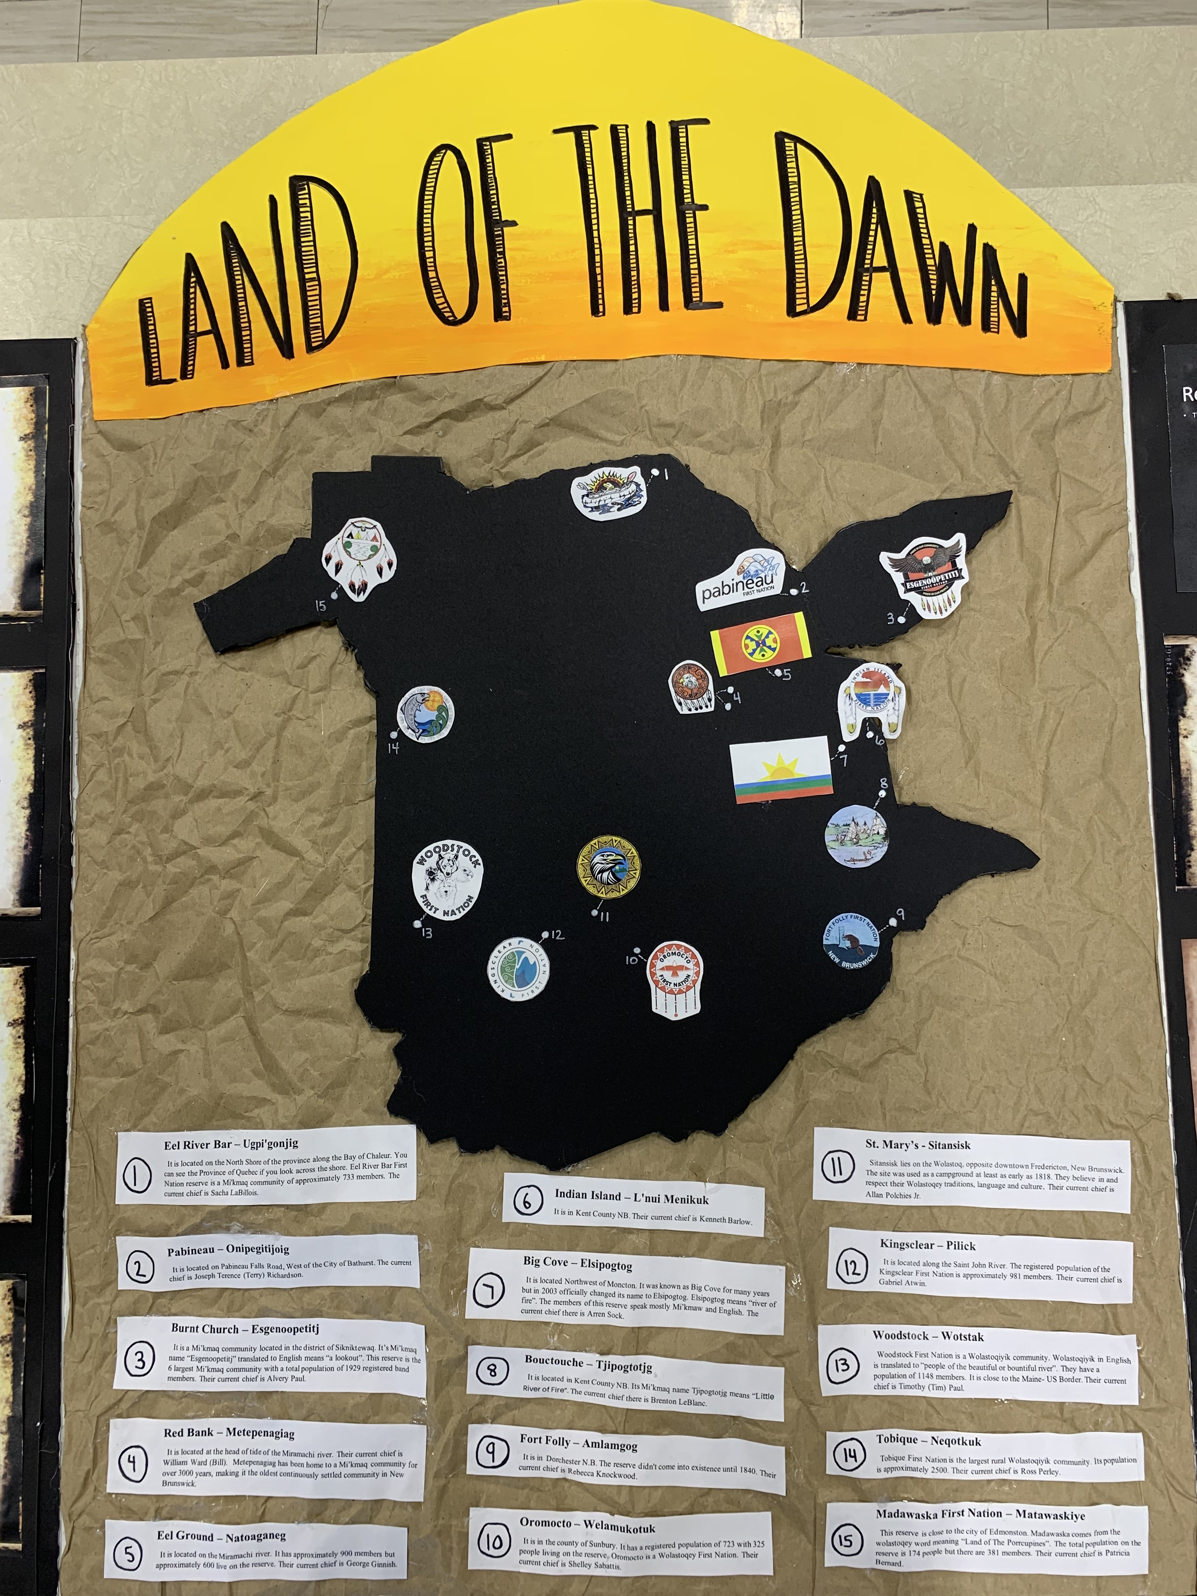

DWF Outcomes
Do Something Grant: Evidence of Success
Student-written land acknowledgements
  Lord Beaverbrook School
  Blackville School
Library upgrades
  Dr. Losier Middle School
  James M. Hill Memorial High School
  Napan Elementary School
School displays
  Bathurst High School
  Bonar Law Memorial High School
  Dr. Losier Middle School
  James M Hill
  King Street Elementary
  Lord Beaverbrook School
  Napan Elementary
  Rexton Elementary

Slide 9
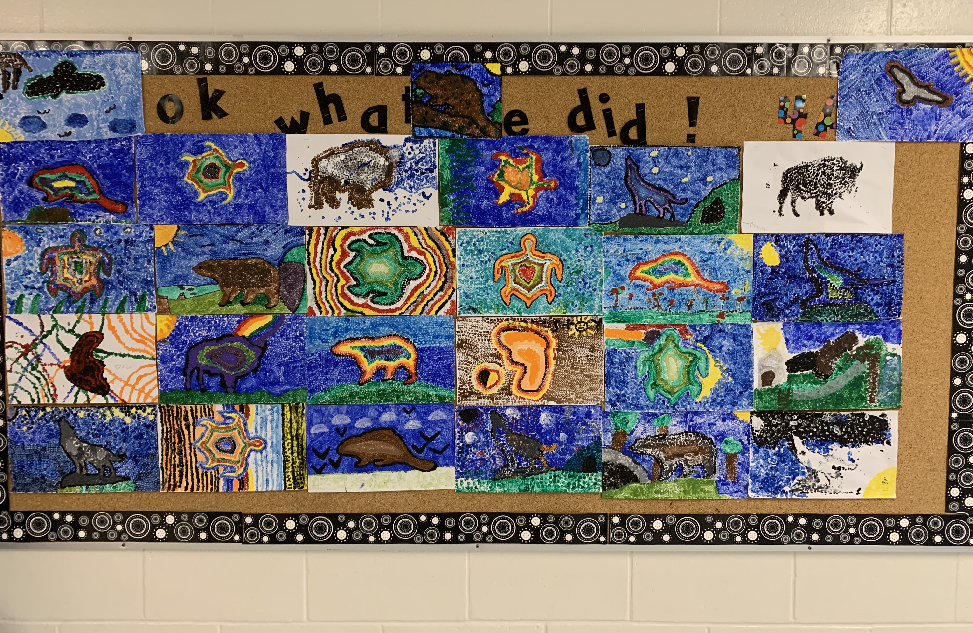
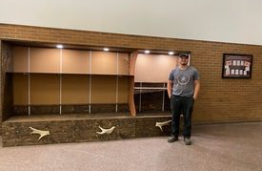
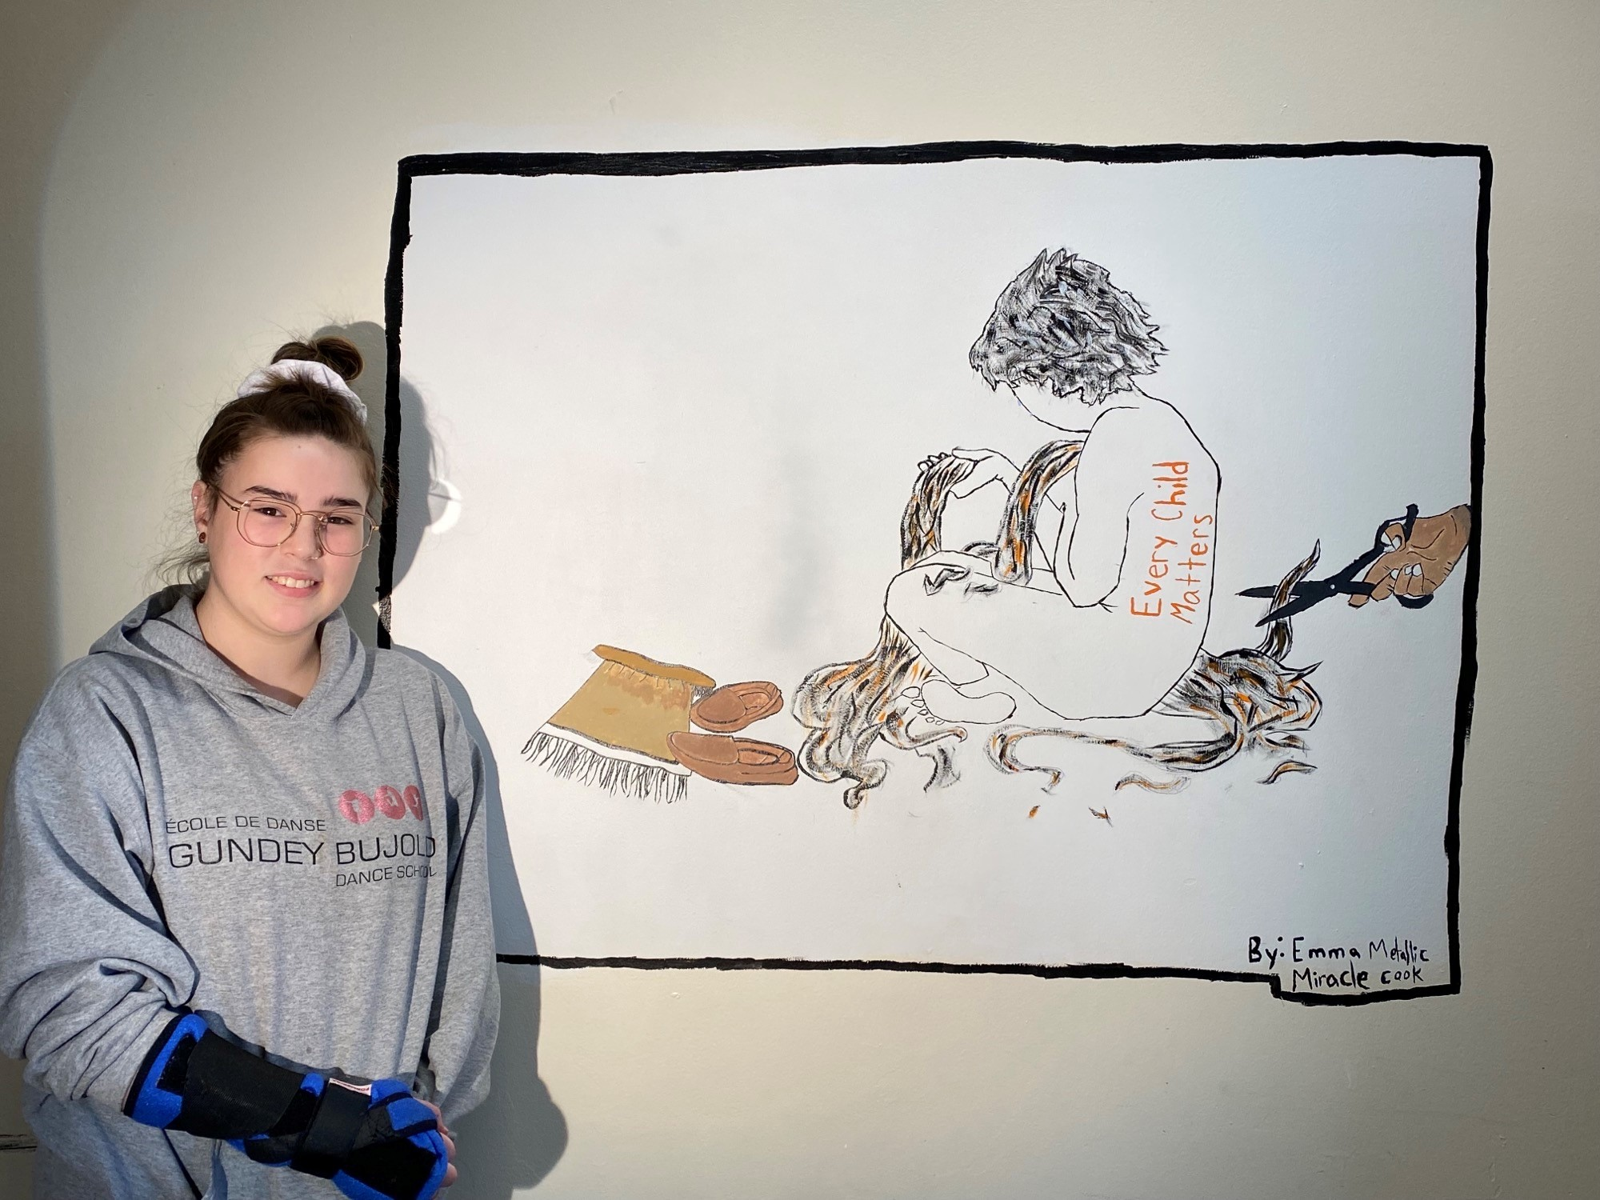
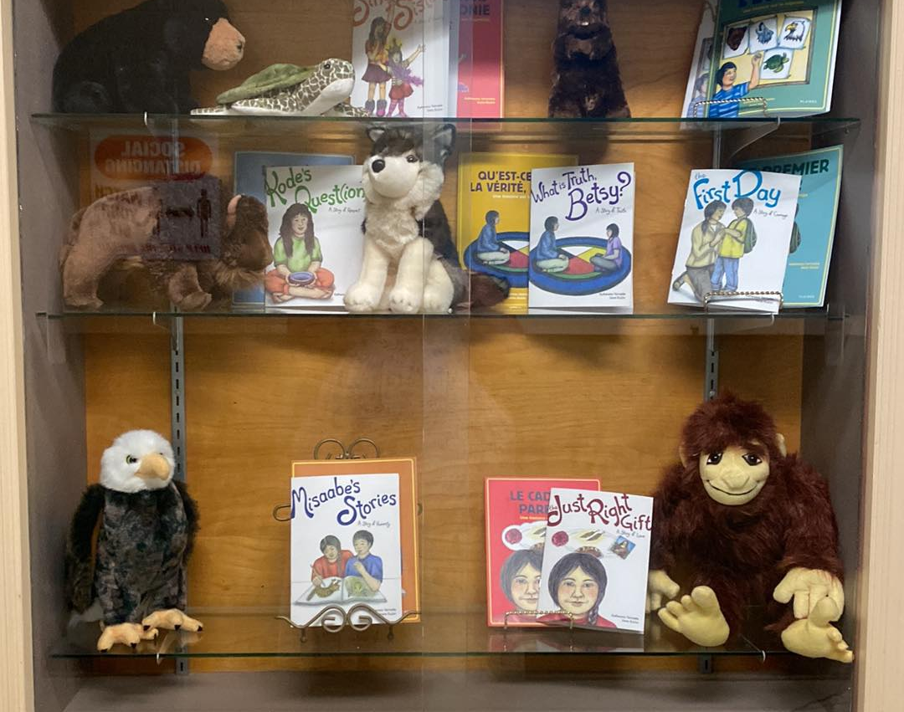
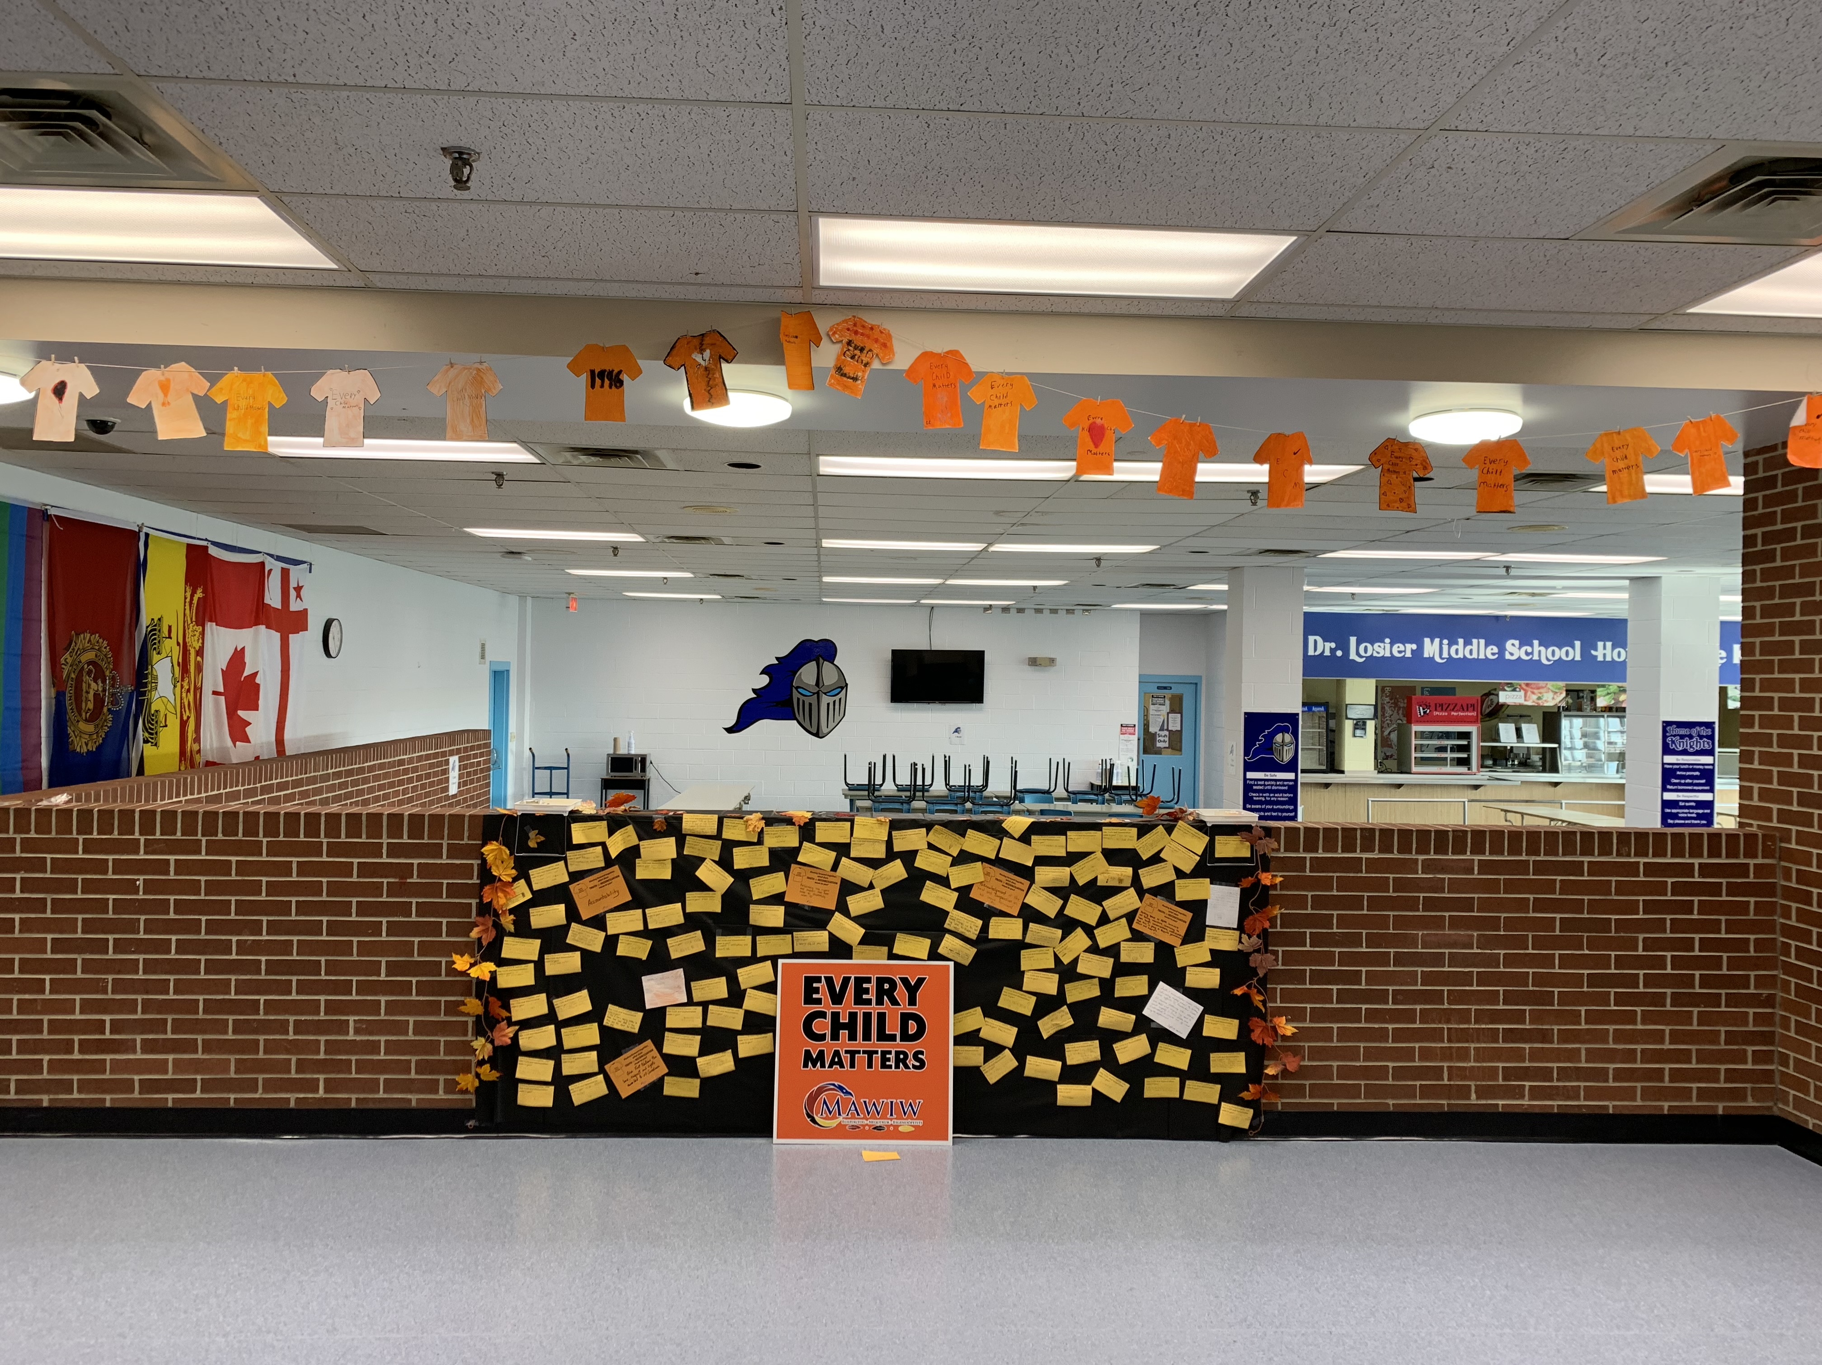

Slide 10
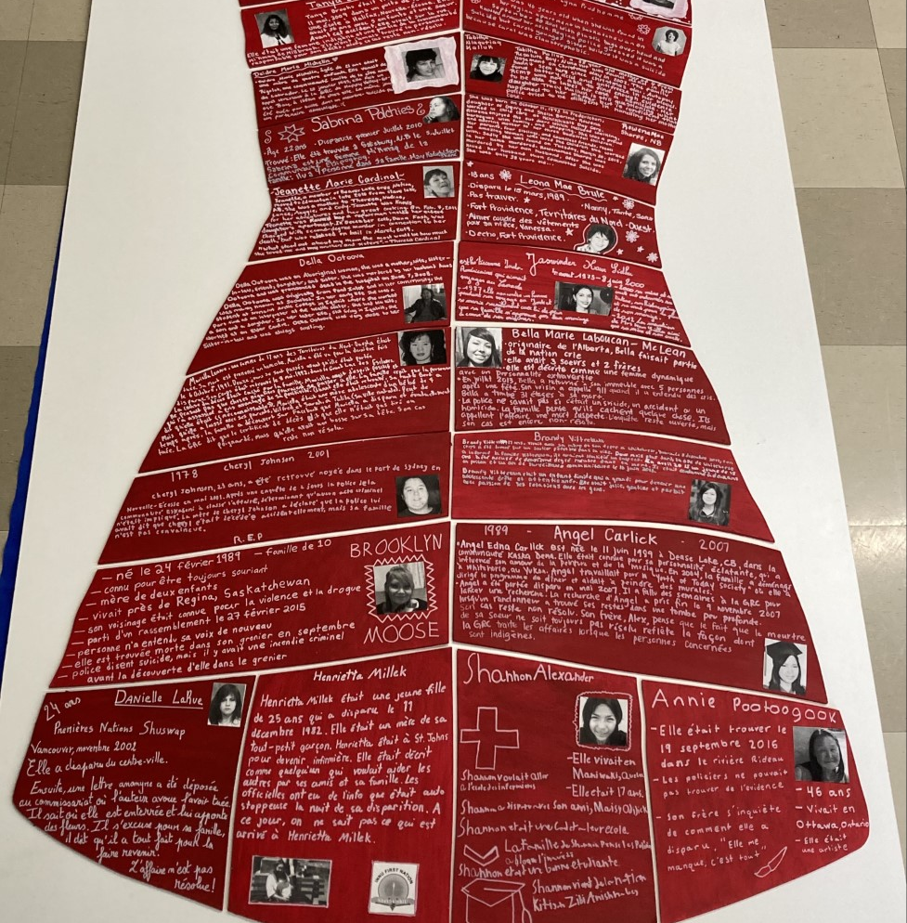
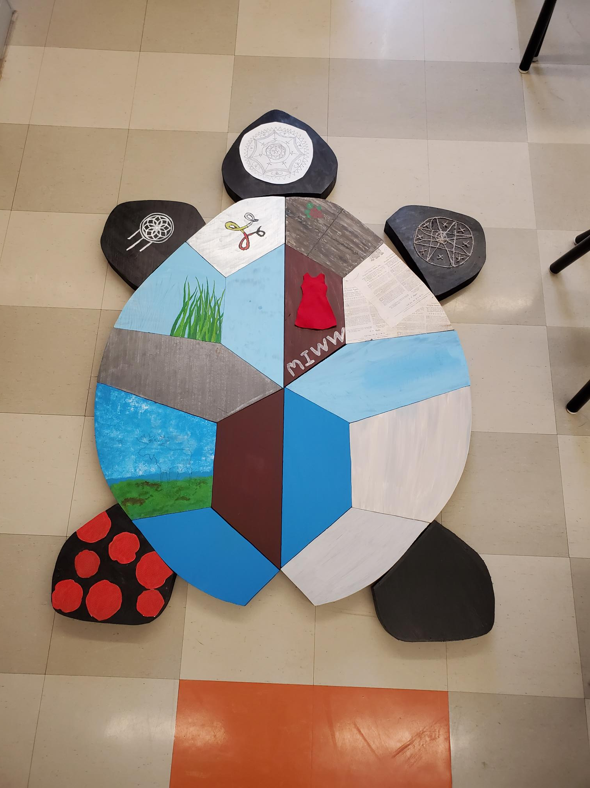
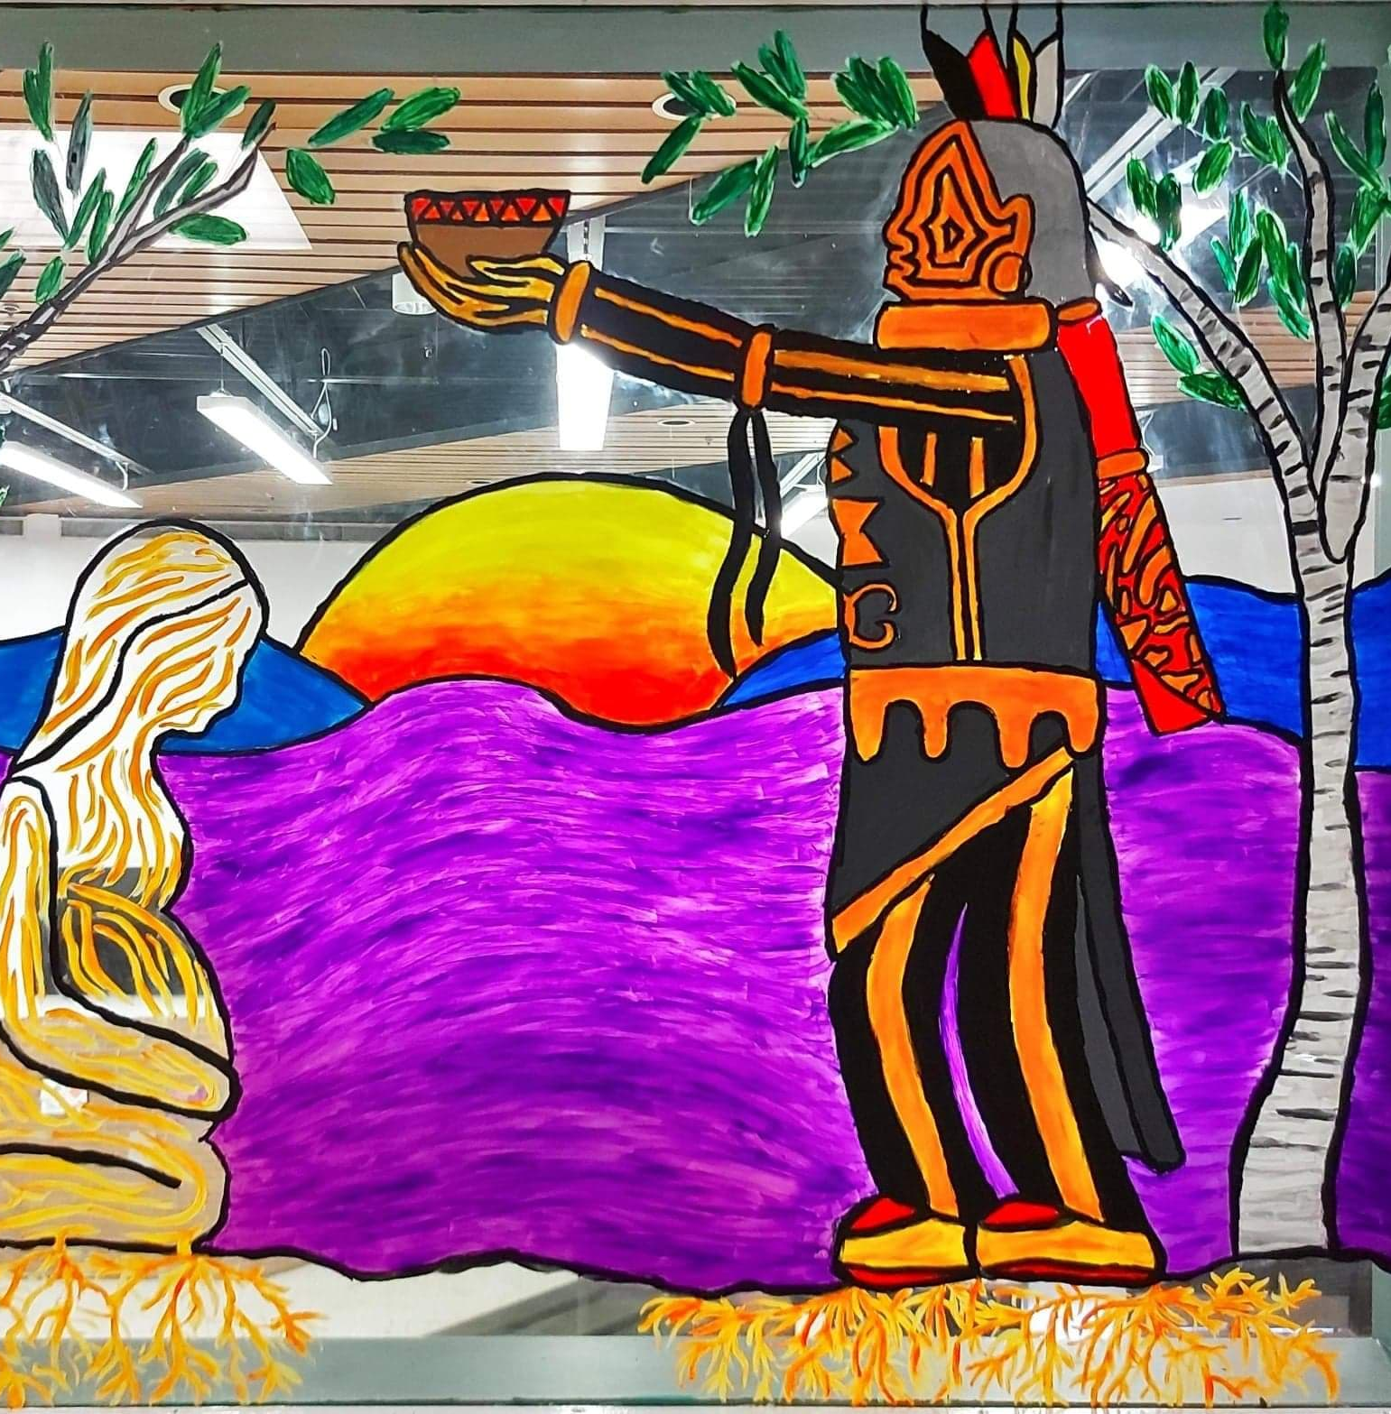
DWF Outcomes continued
Arts and Culture Projects
  Bathurst High School
  Bonar Law Memorial
  Eleanor W. Graham
  Max Aitken Academy
  NSER
  Parkwood Elementary School​
  Rexton Elementary​
  Superior Middle School​
  Terry Fox Elementary

Slide 11
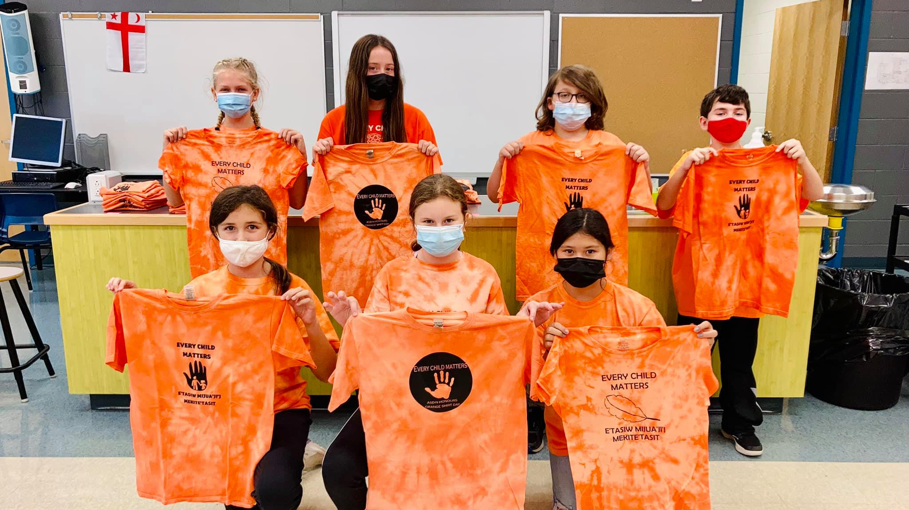
Truth and Reconciliation Week
In addition to providing curricular support to teachers for Orange Shirt Day and Truth and Reconciliation Week, the FNE team supported many special projects across the district.
Orange T-Shirt Project
  Students at Max Aitken Academy hand-produced 600 orange t-shirts and 150 buttons and distributed them across ASD-N
  Total sales = $11,734
  Sales were matched by ASD-N and donated to Ugpi'ganjig Elders, The Orange Shirt Society, Natoaganeg Community Food Center, and the Residential School Survivor Society

Slide 12
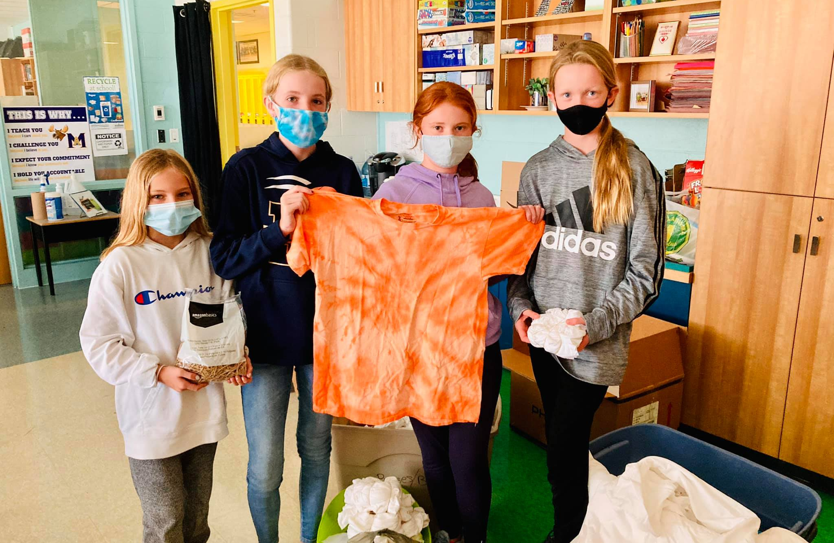
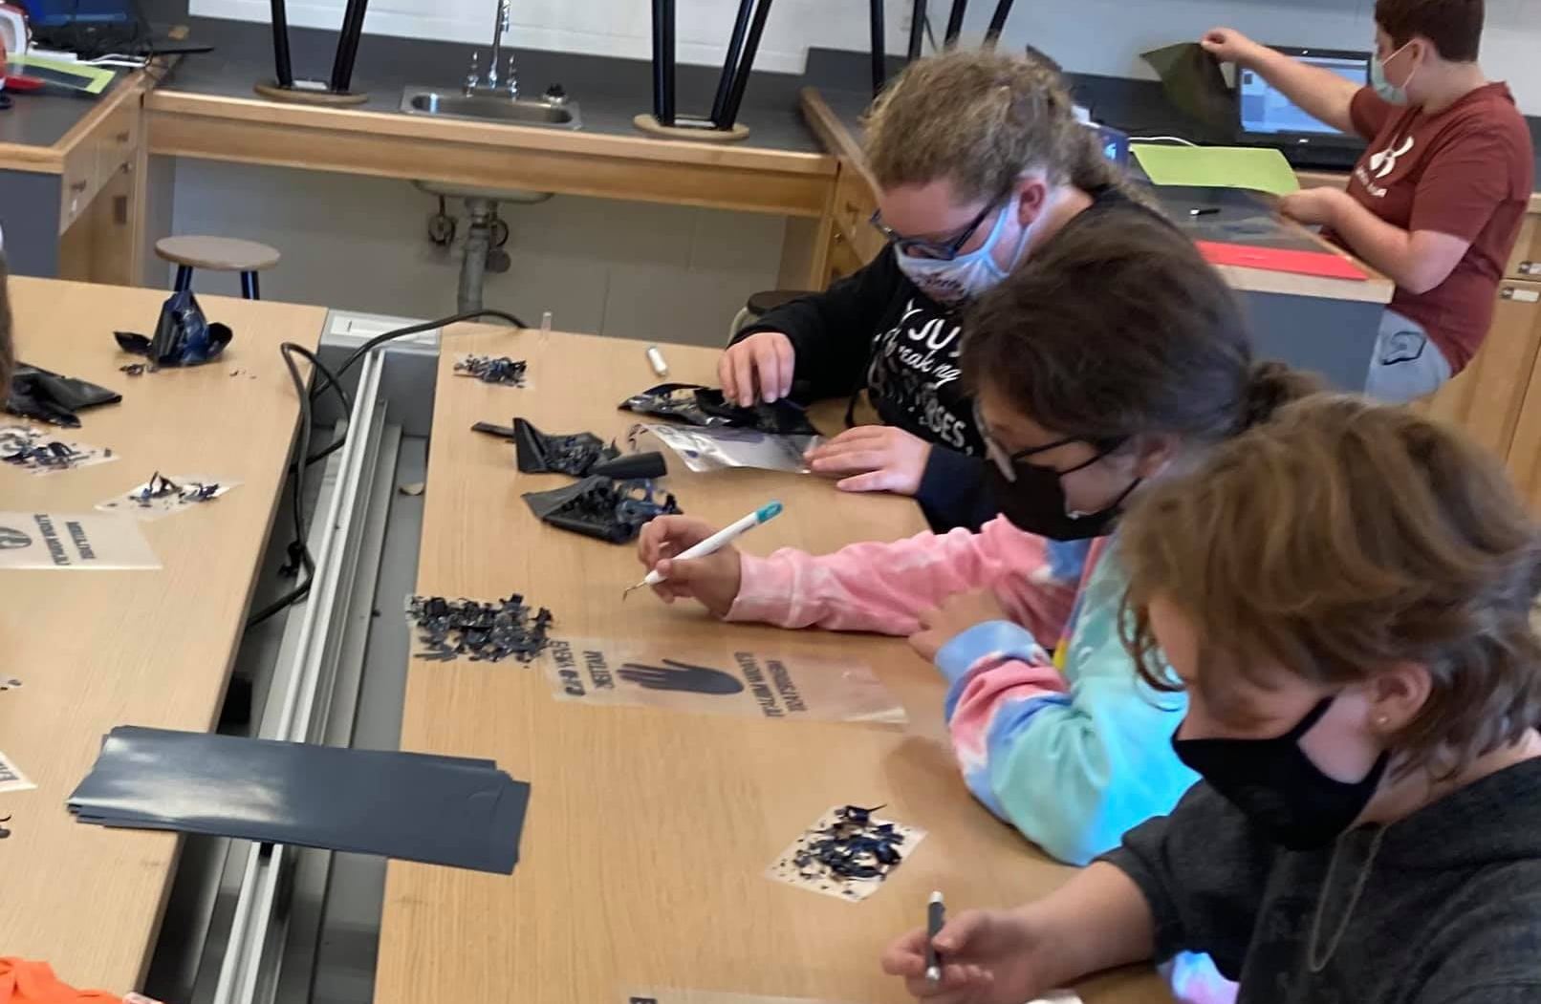
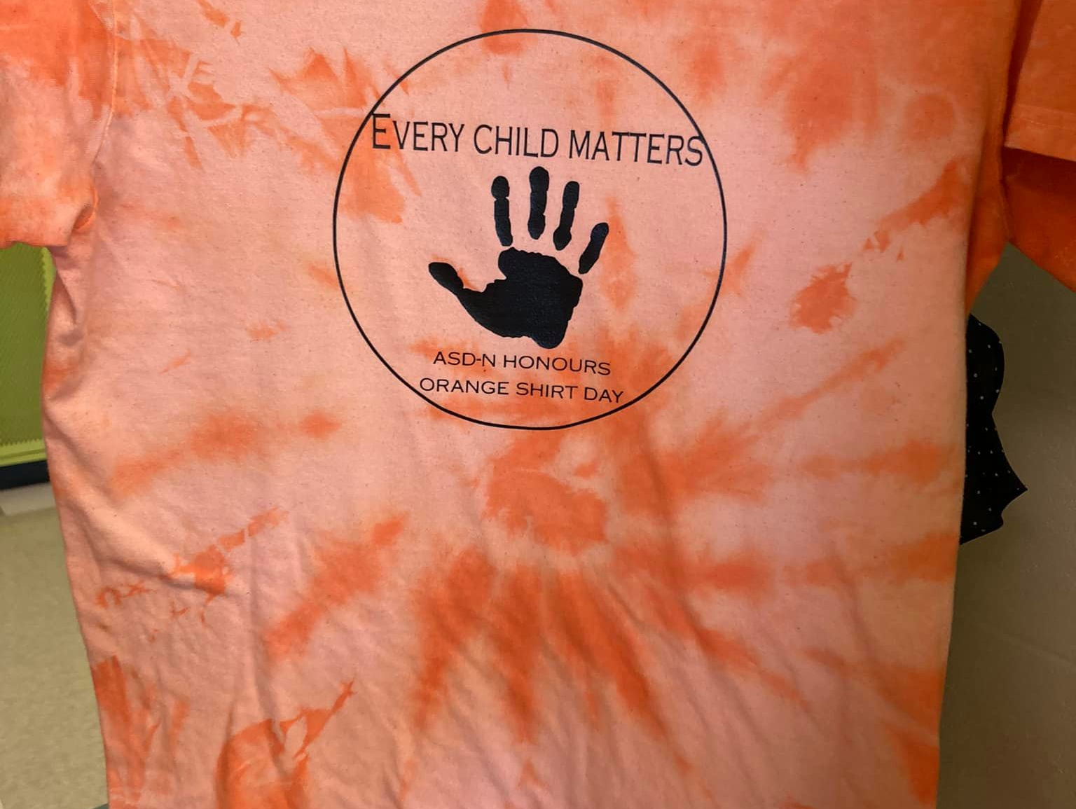
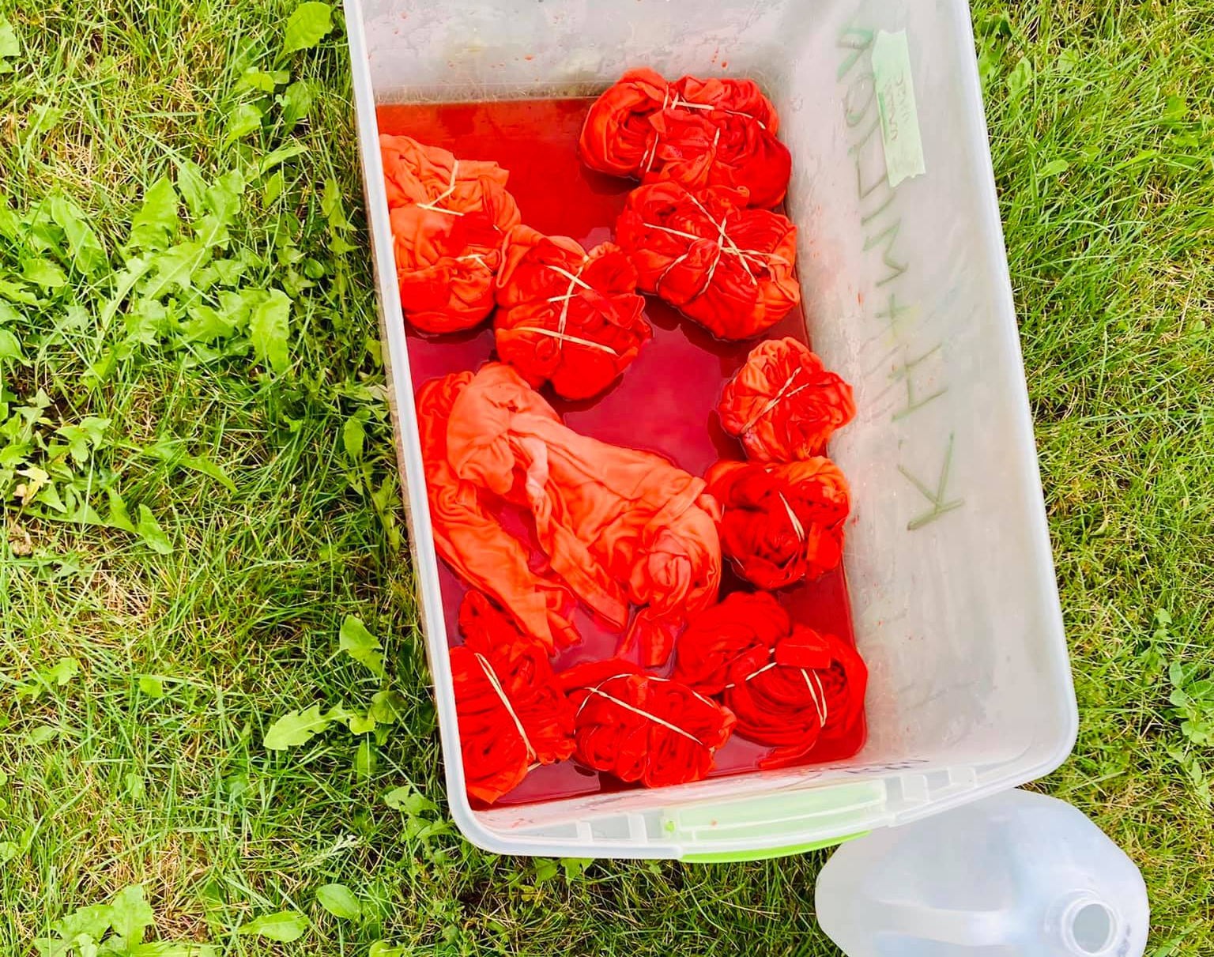
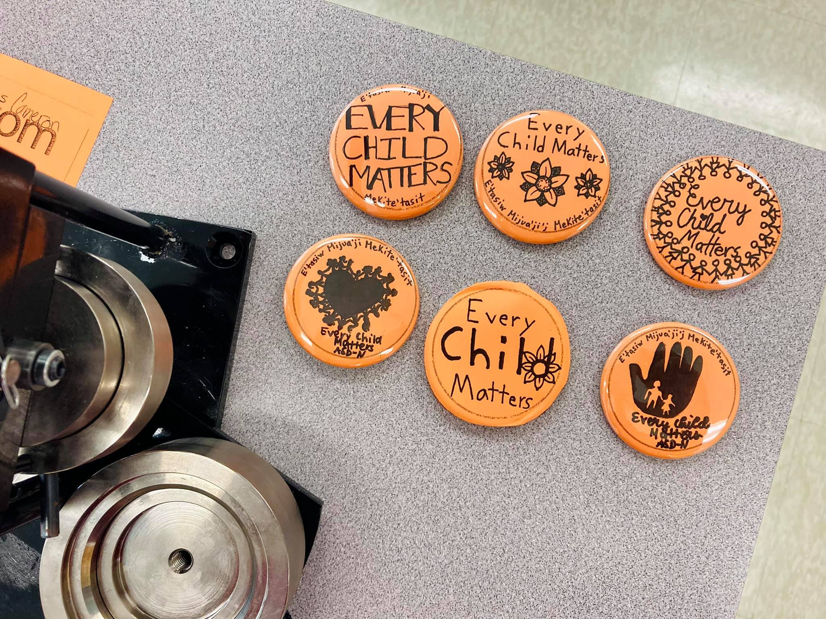

Slide 13

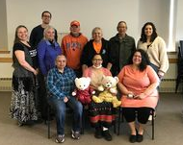
Elders in Schools
Professional Learning
  Unanimous positive feedback from educators
  Led to a rise in requests for Elders in Schools
  Fostered a baseline relationship between educators and Elders before classroom visits, which led to more positive visits for students, educators and Elders alike
Elders' gathering
  Provided an opportunity for Elders to engage with one another
  Reflection on experiences in classrooms – successes and challenges
  Planning: Elders provided feedback on needs and goals for the future of the program

Slide 14
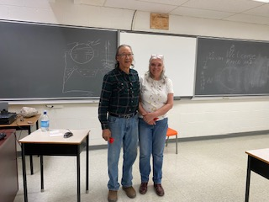
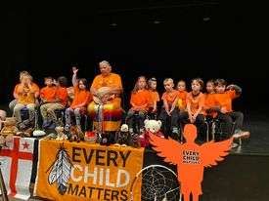
Elders in Schools
Classroom visits
  Over half of ASD-N schools participated in the program
  Notable successes:
    Weekly visits at L.E. Reinsborough School with Elder Roseann Martin resulting in a song recording by kindergarten students
    Weekly visits with First Nations Visual Arts 110 students with Elder Joseph Leonard Ward and Sarah Ward resulting in completed moccasins
    Weekly visits with Superior Middle School, Terry Fox and Parkwood Elementary by Marie Kryszko to learn about the Seven Sacred Teachings, ending with a trip to Pabineau First Nation

Slide 15
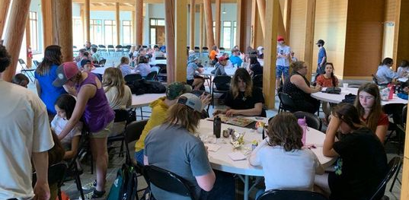
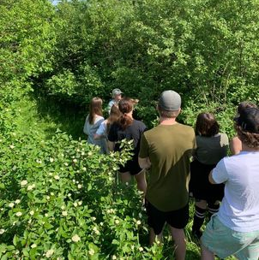
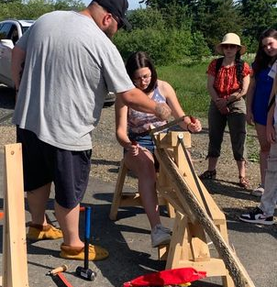
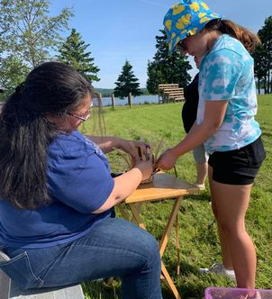
Take Me Outside
The middle school students of DRHS spent a full day at the Aboriginal Heritage Gardens in Eel River Bar in June. They learned how the ash tree is connected to Mi'kmaq creation, scraped and pounded ash for baskets, helped weave a basket of their own, went on a medicine walk, and played games before indulging in a feast of moose stew and luskinigan.

Slide 16
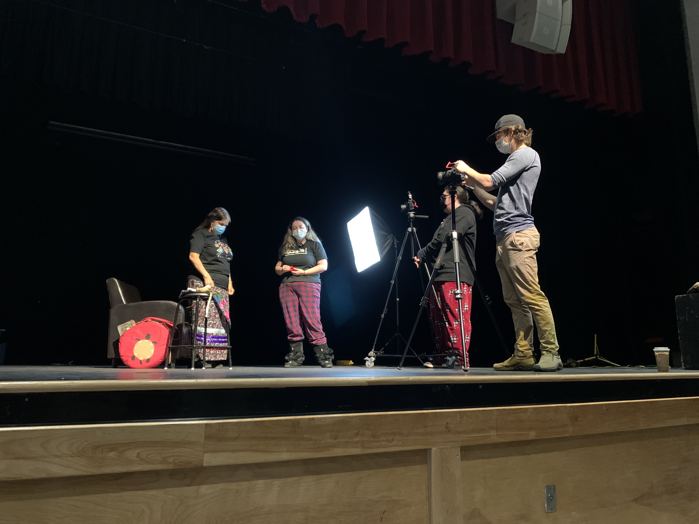
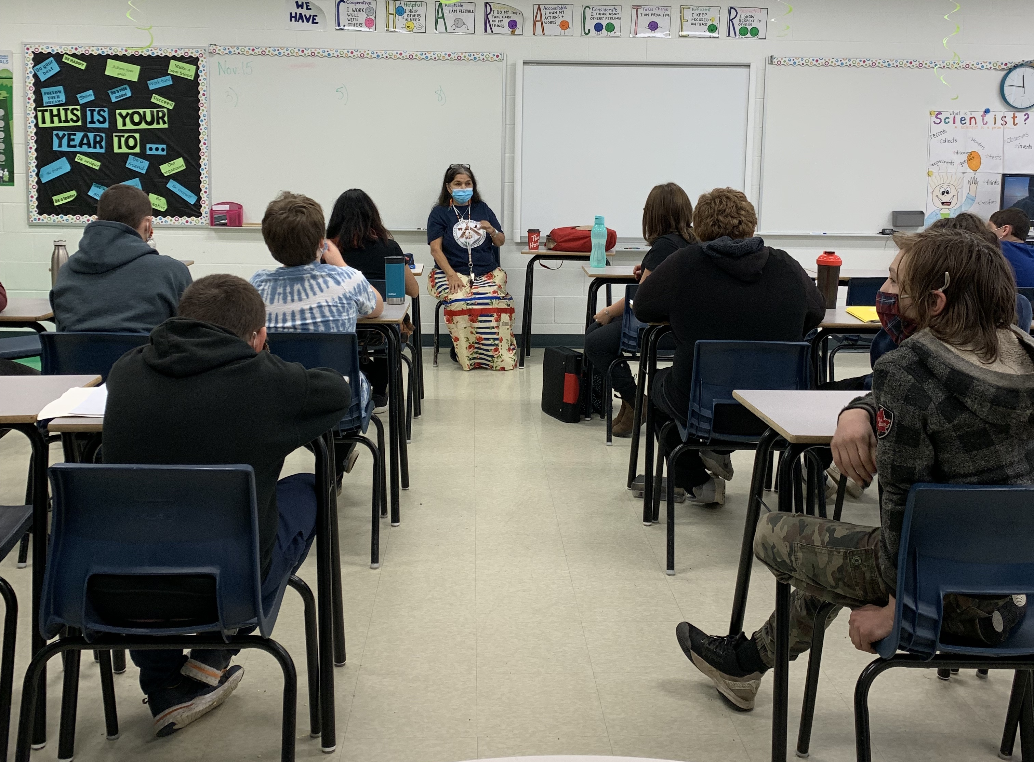
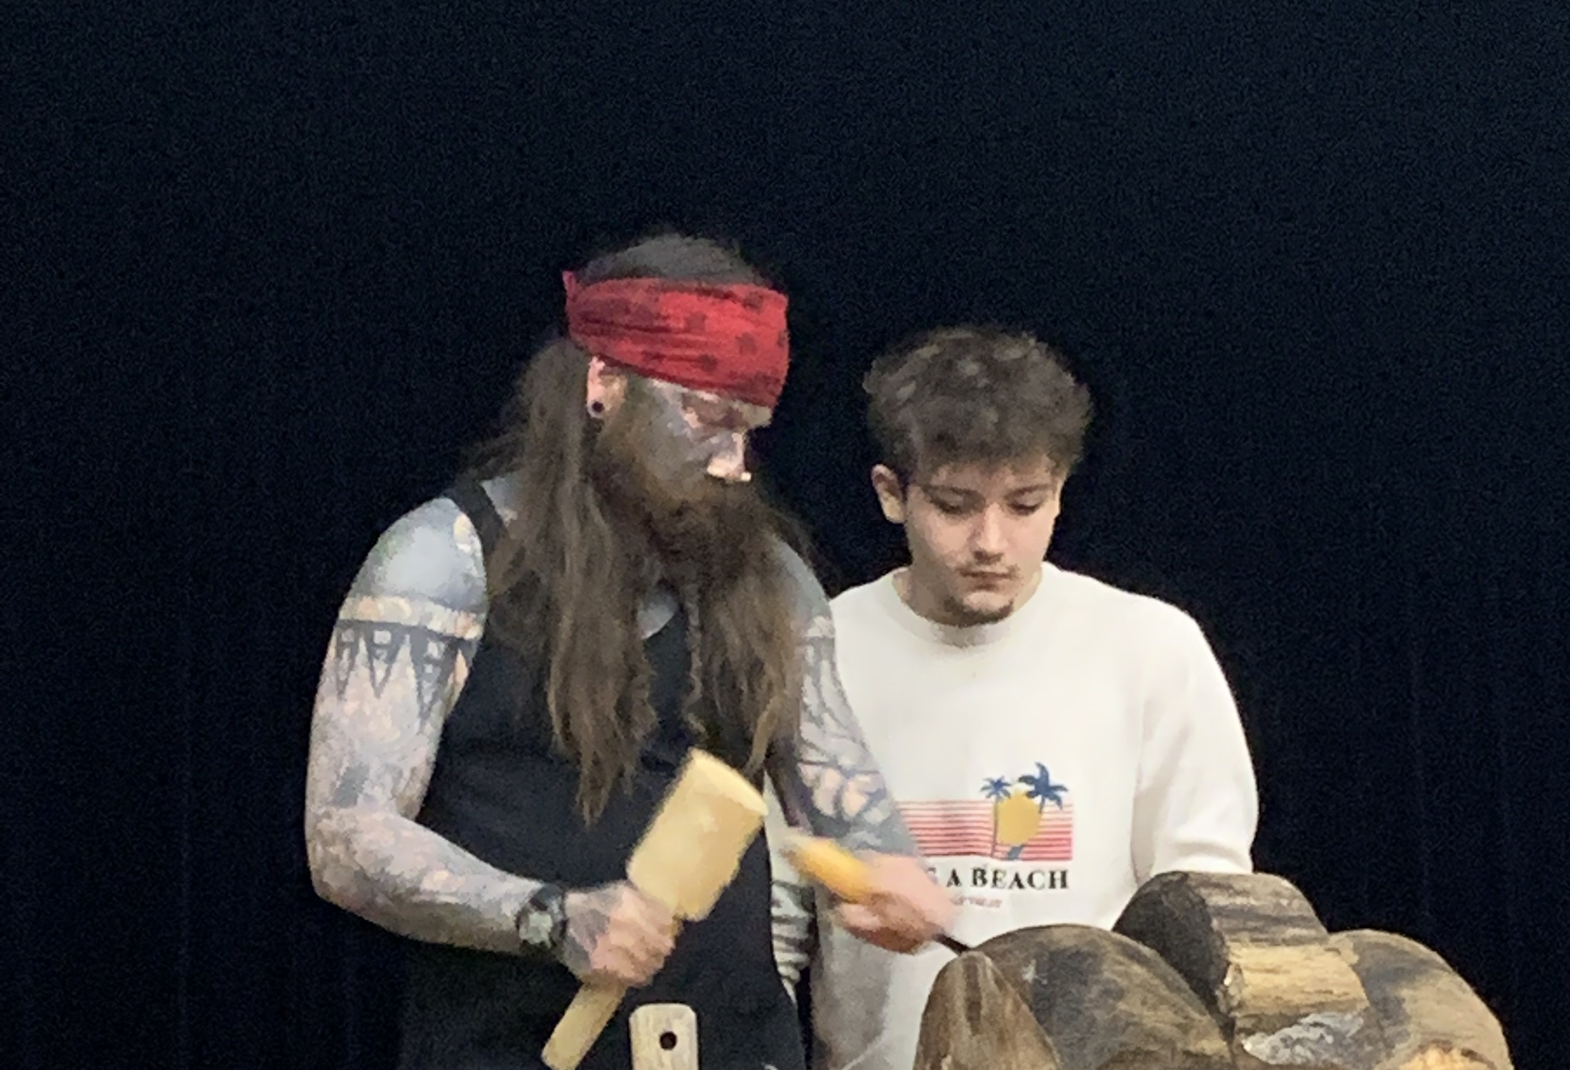
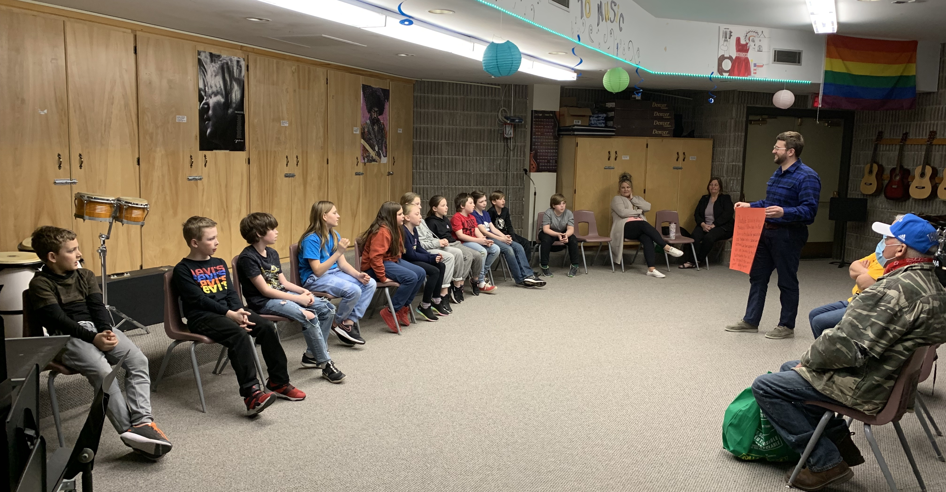
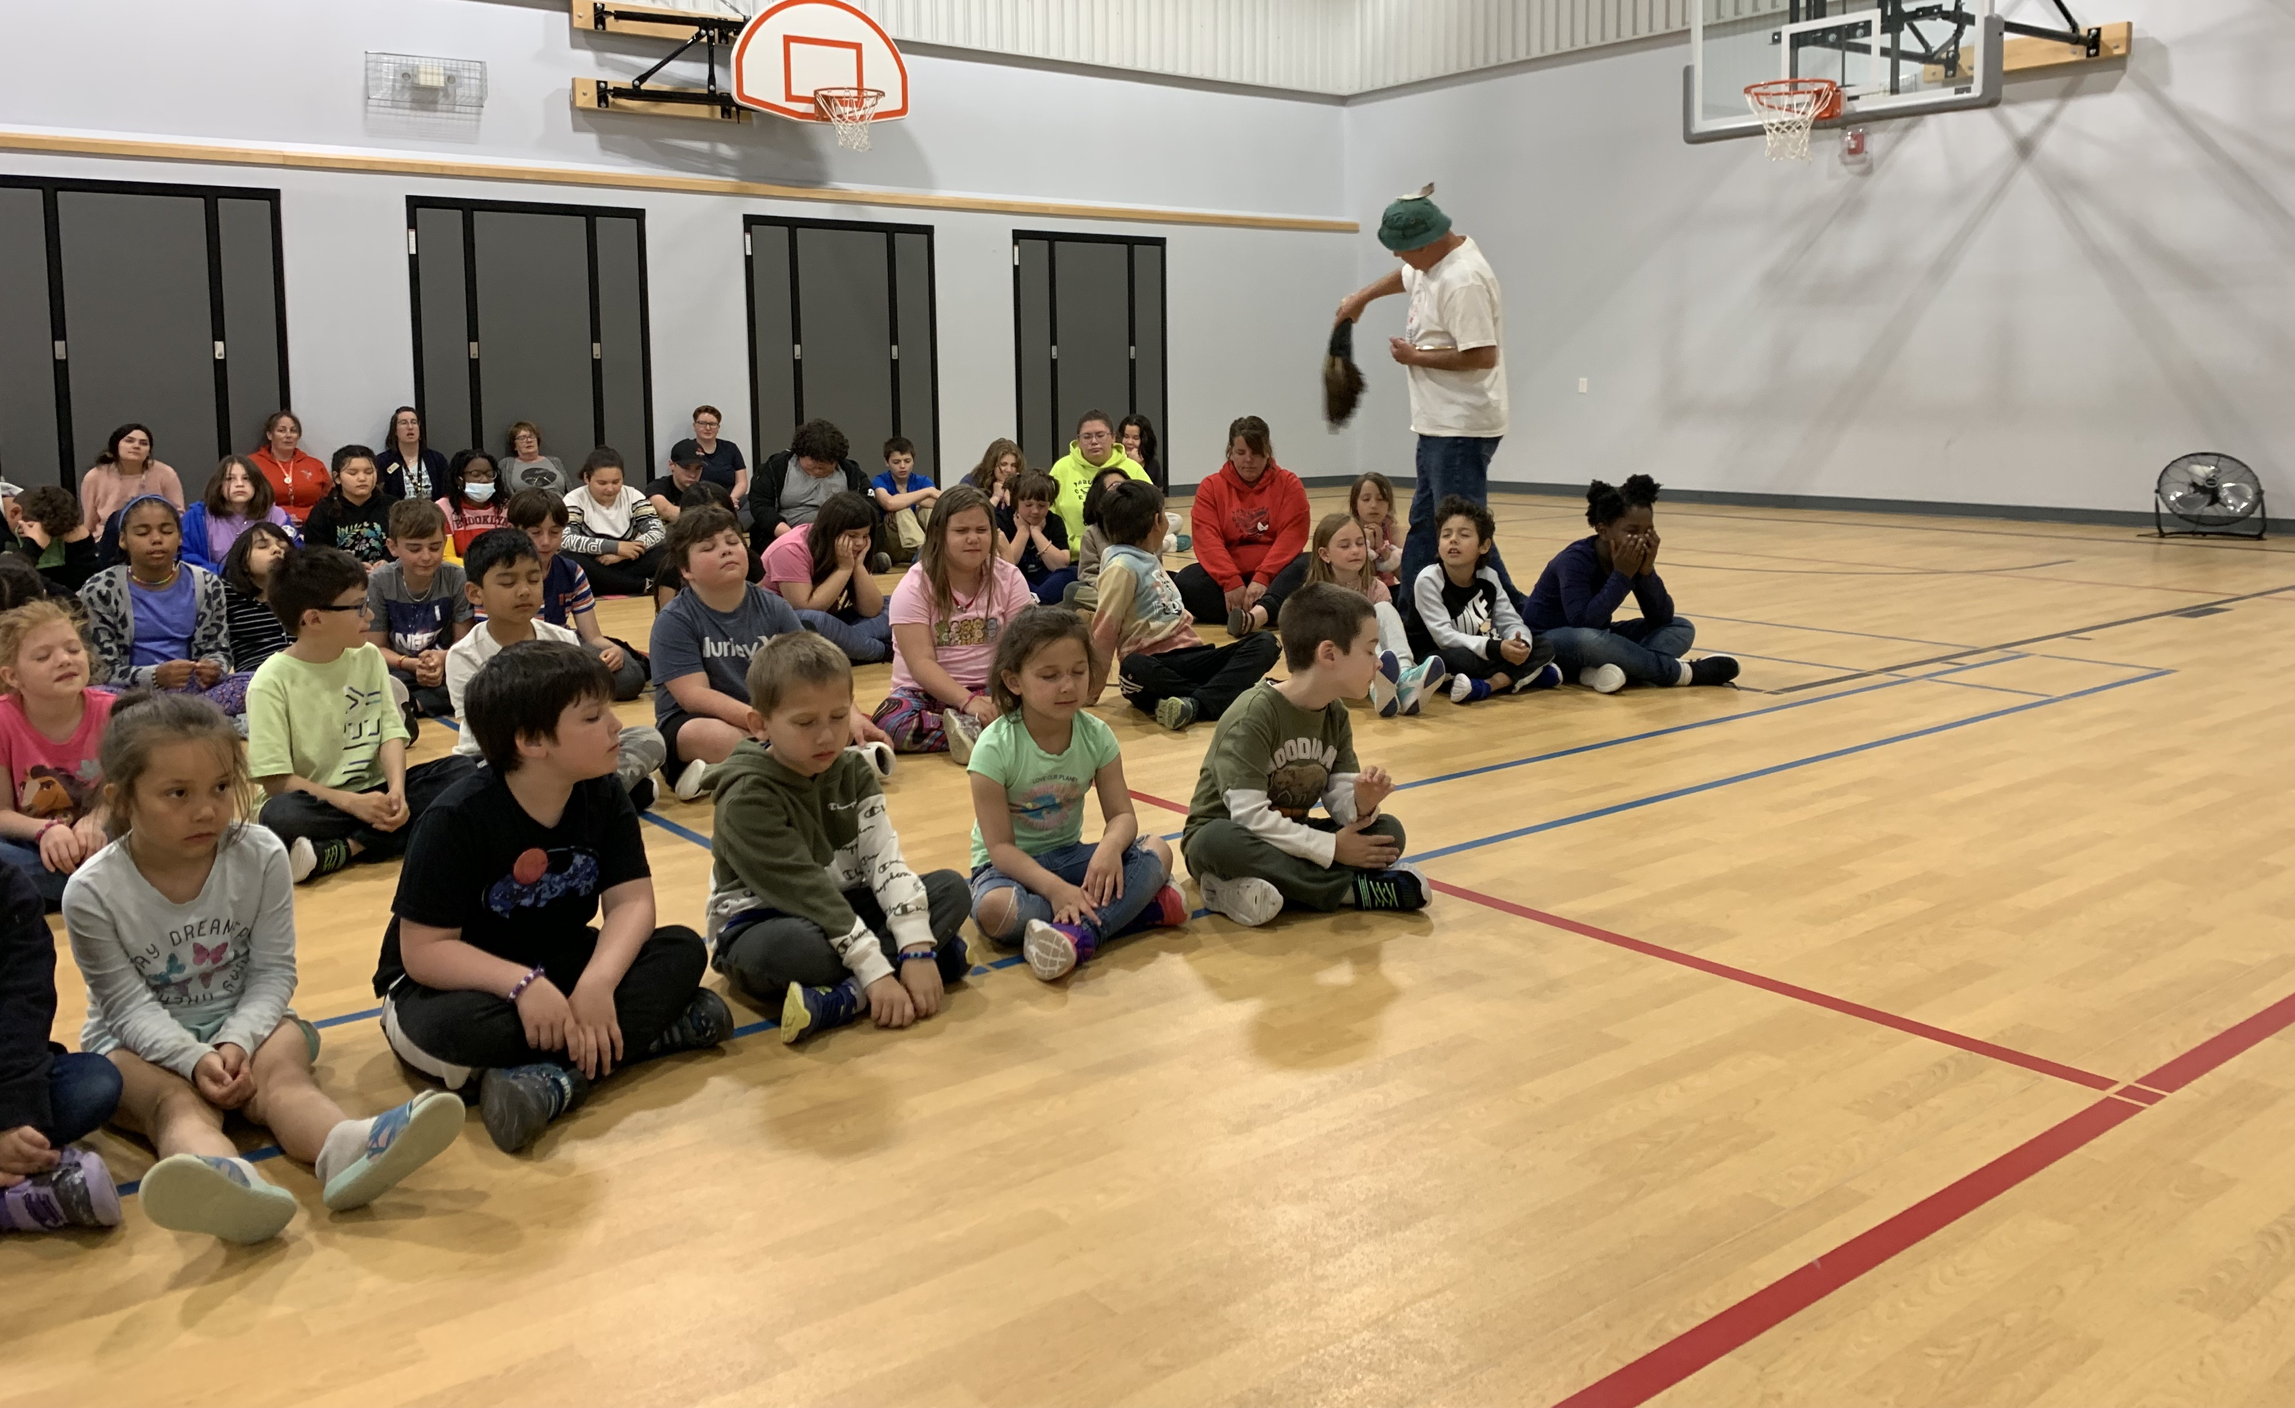
From sharing important lessons, to sharing their craft, to being featured in and giving feedback on student projects, Elders in Schools play many roles in the classroom.

Slide 17
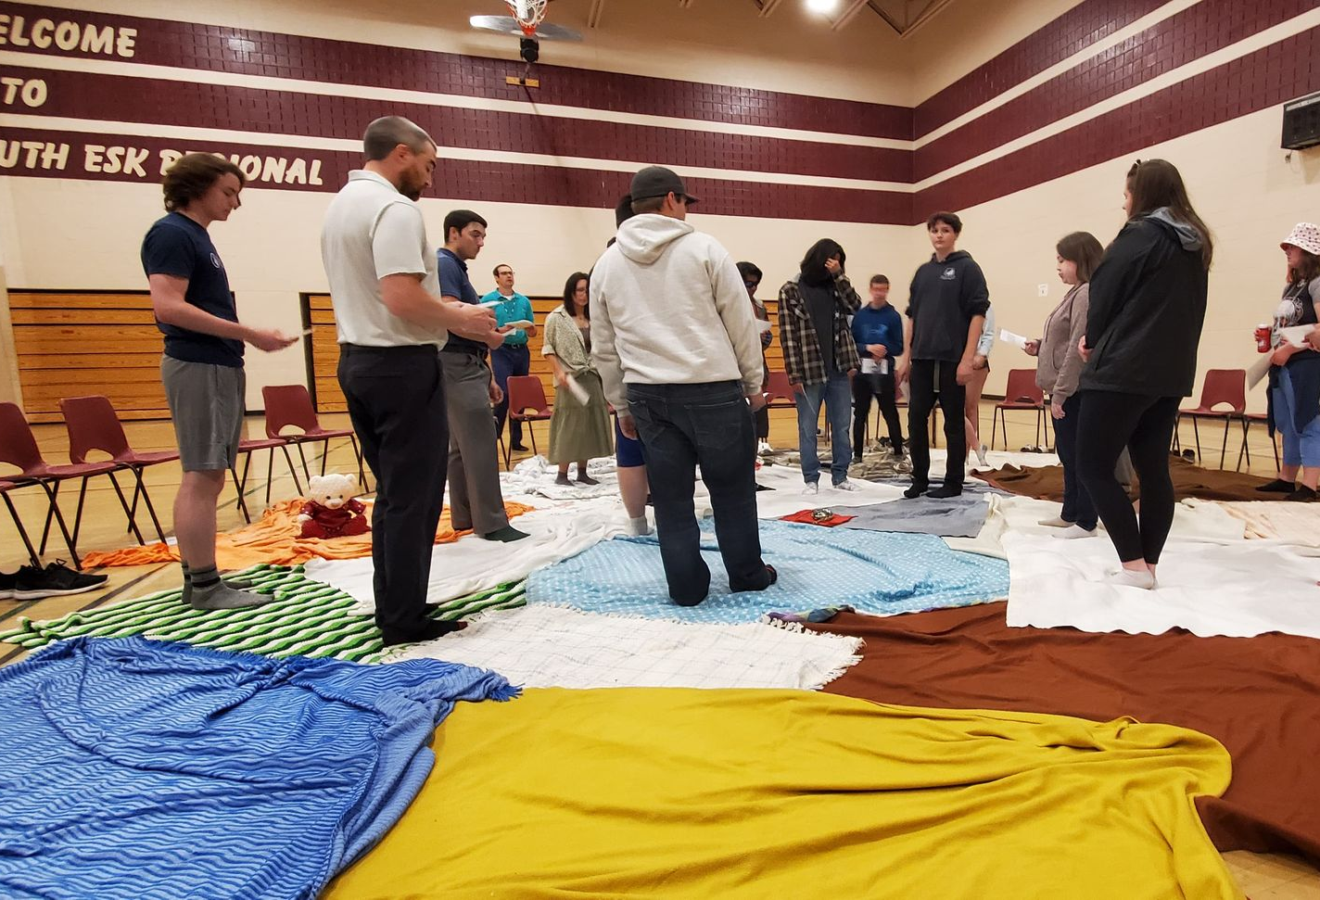
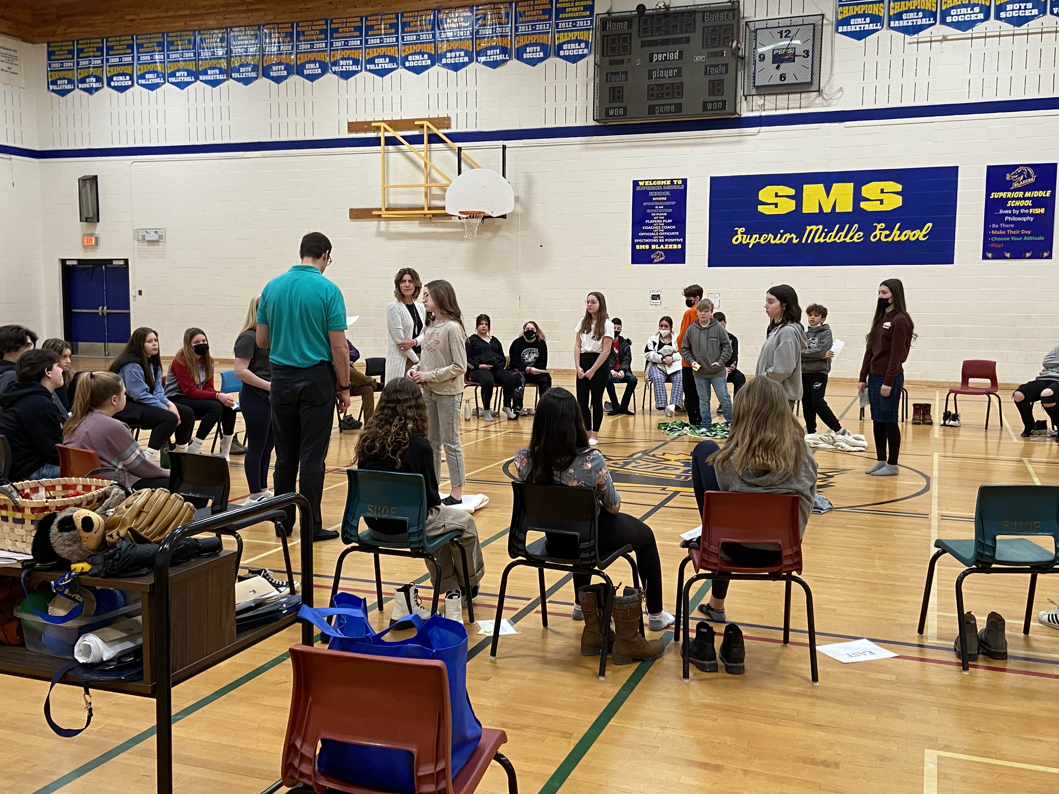
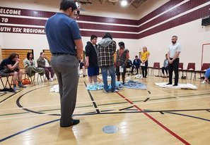
Blanket Exercises
Conducted for grade 8 students at Superior Middle School as the culmination of their Heritage Fair projects
Conducted for middle and high school students at NSER

Slide 18
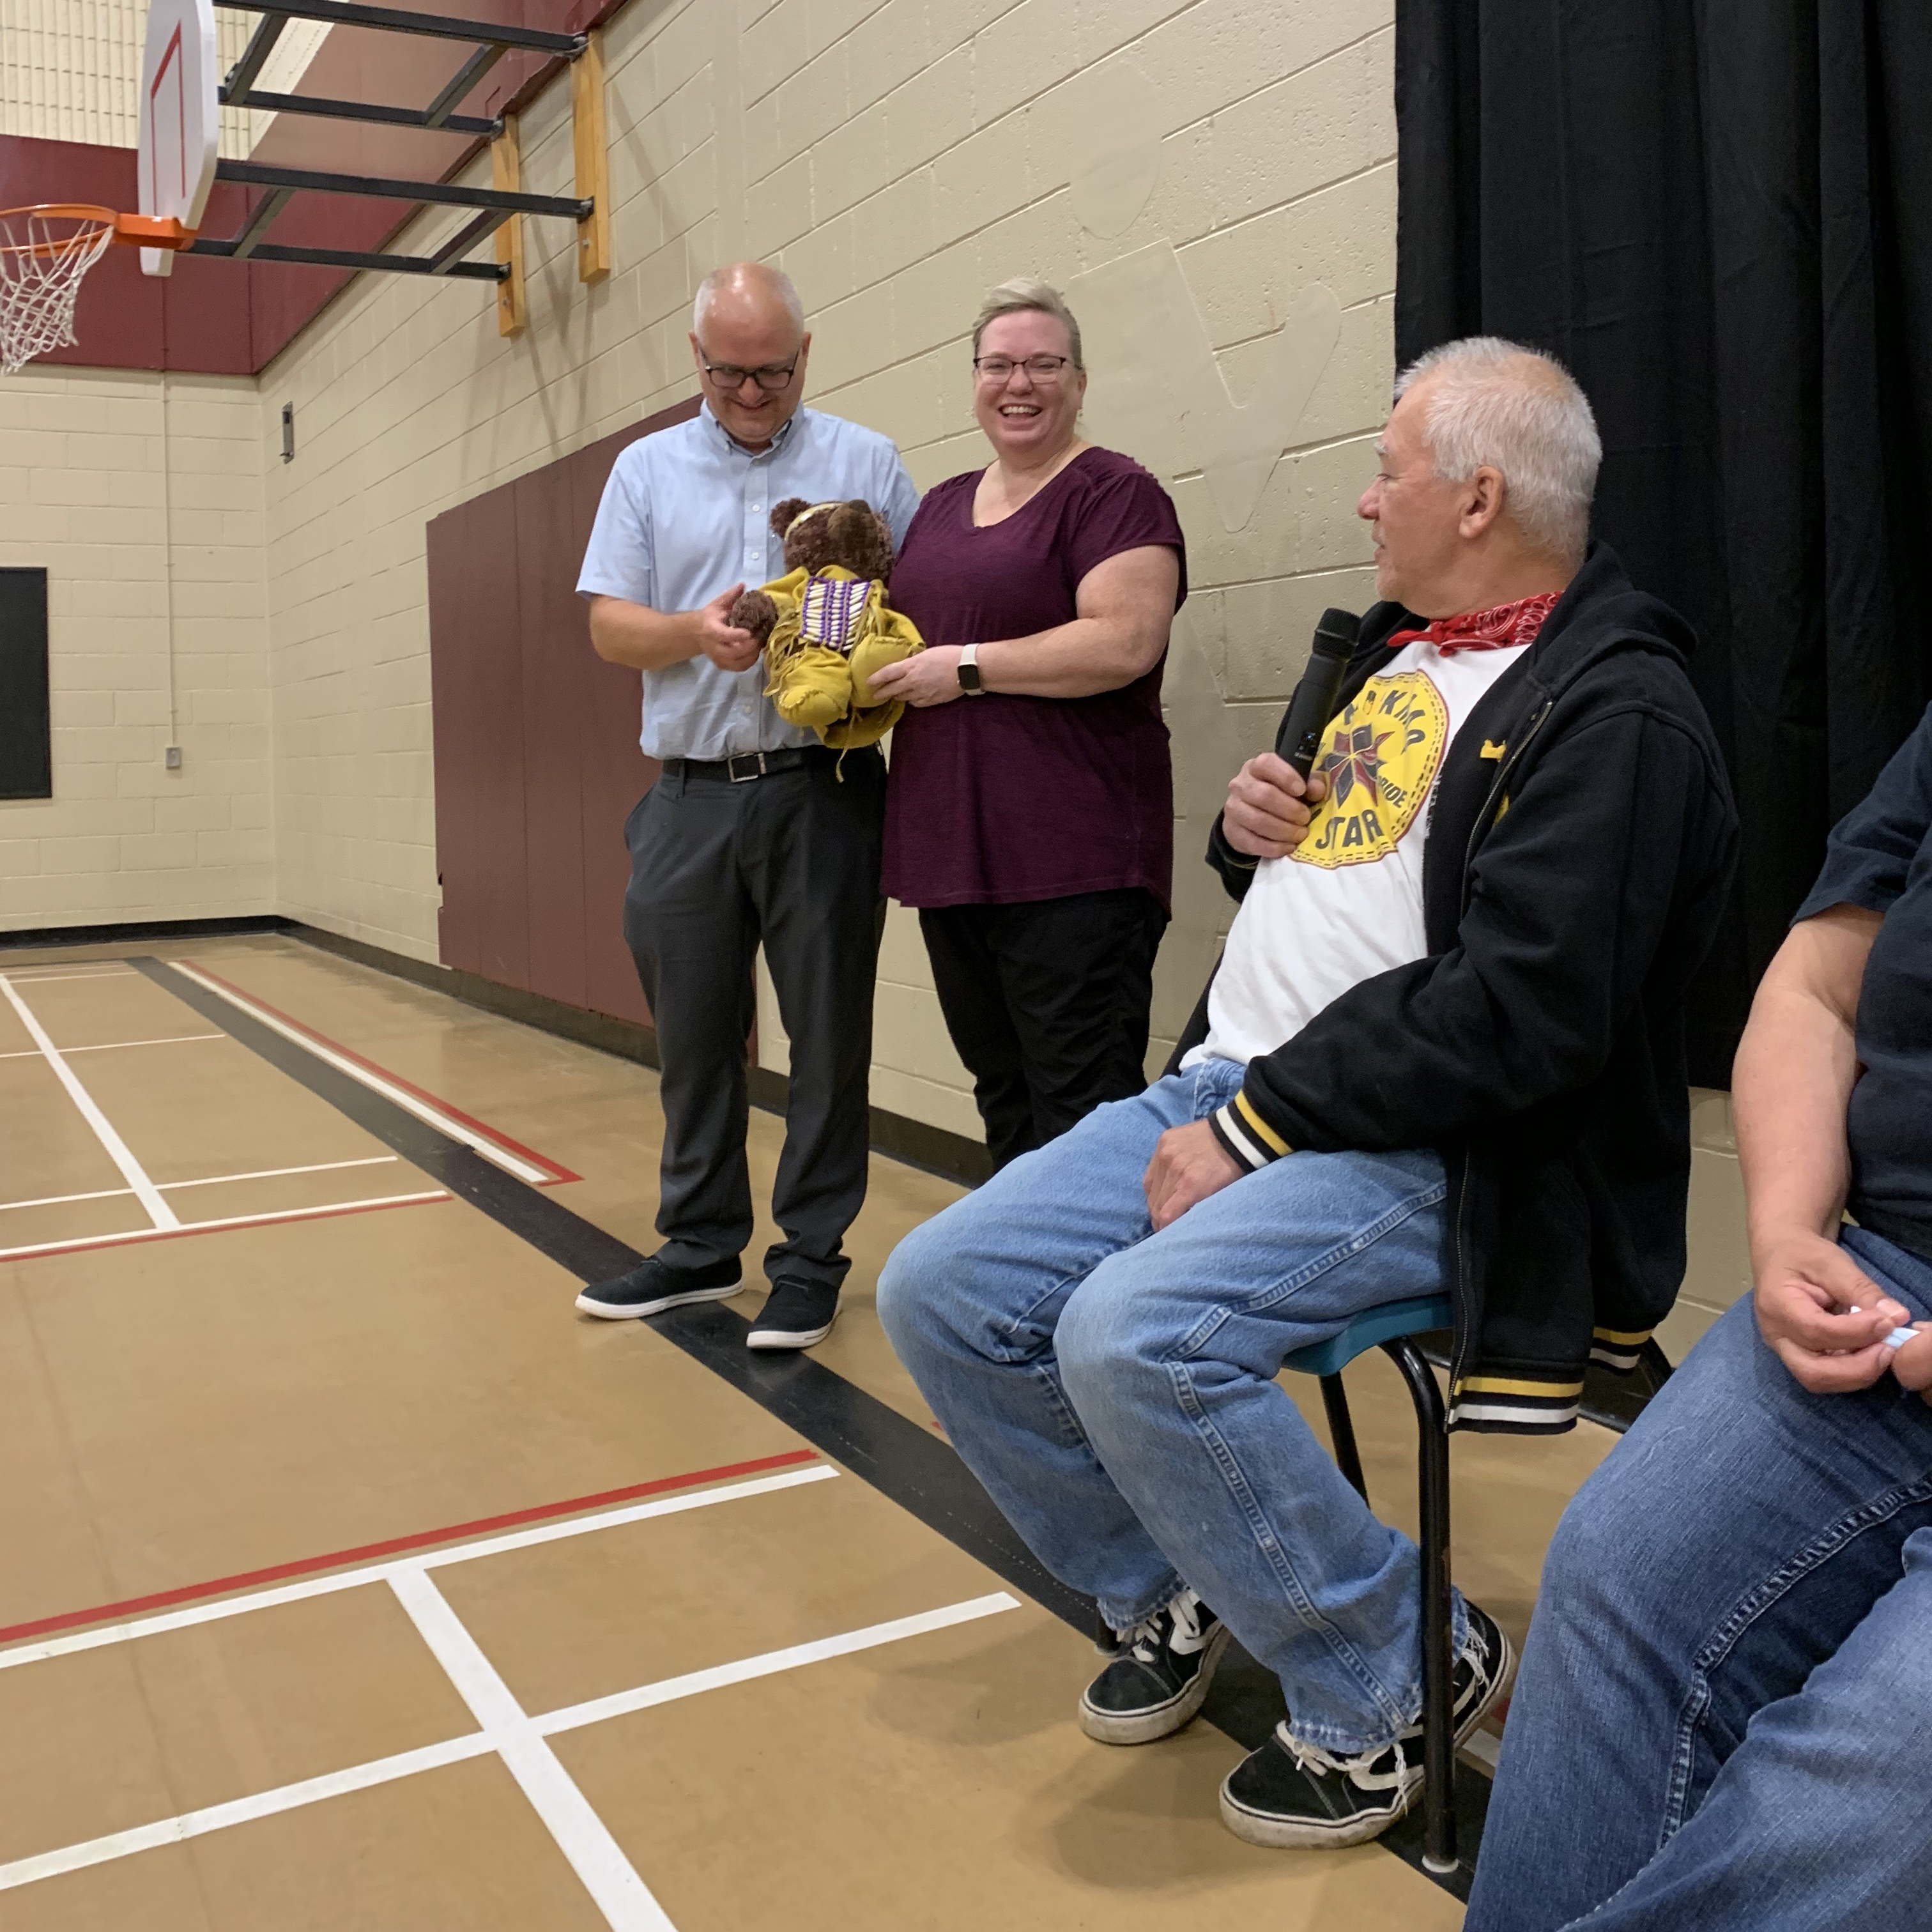
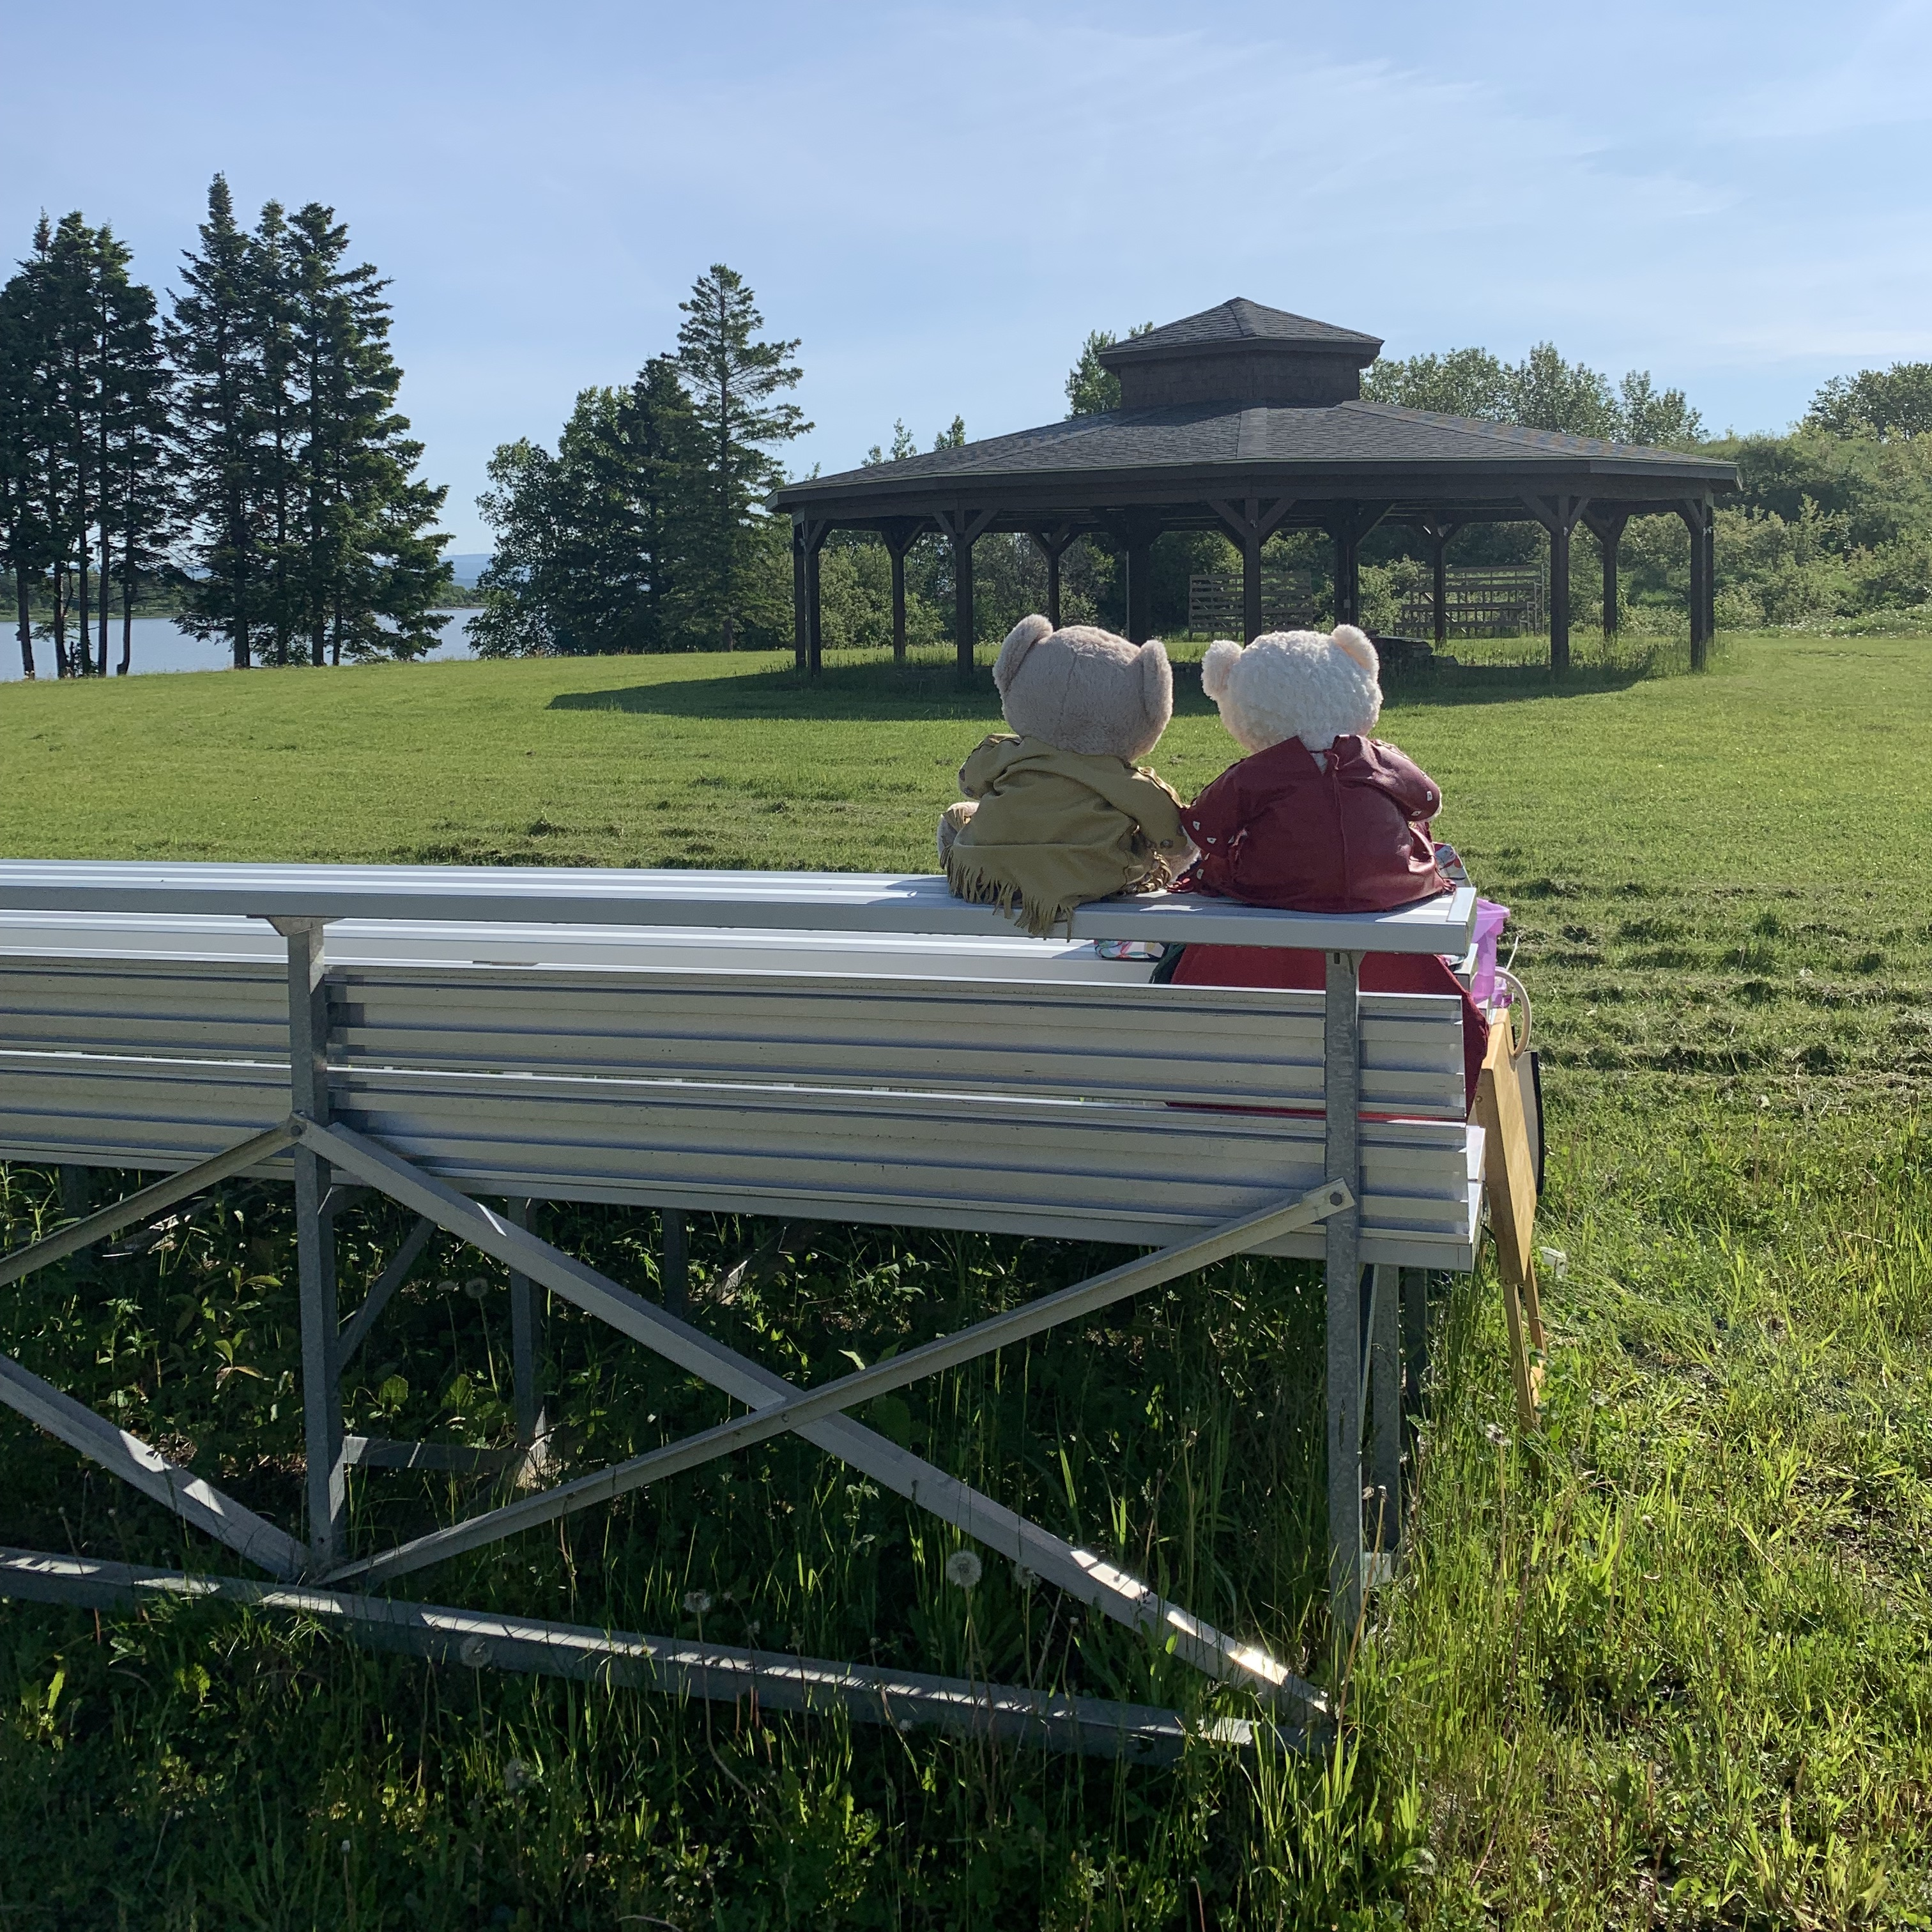
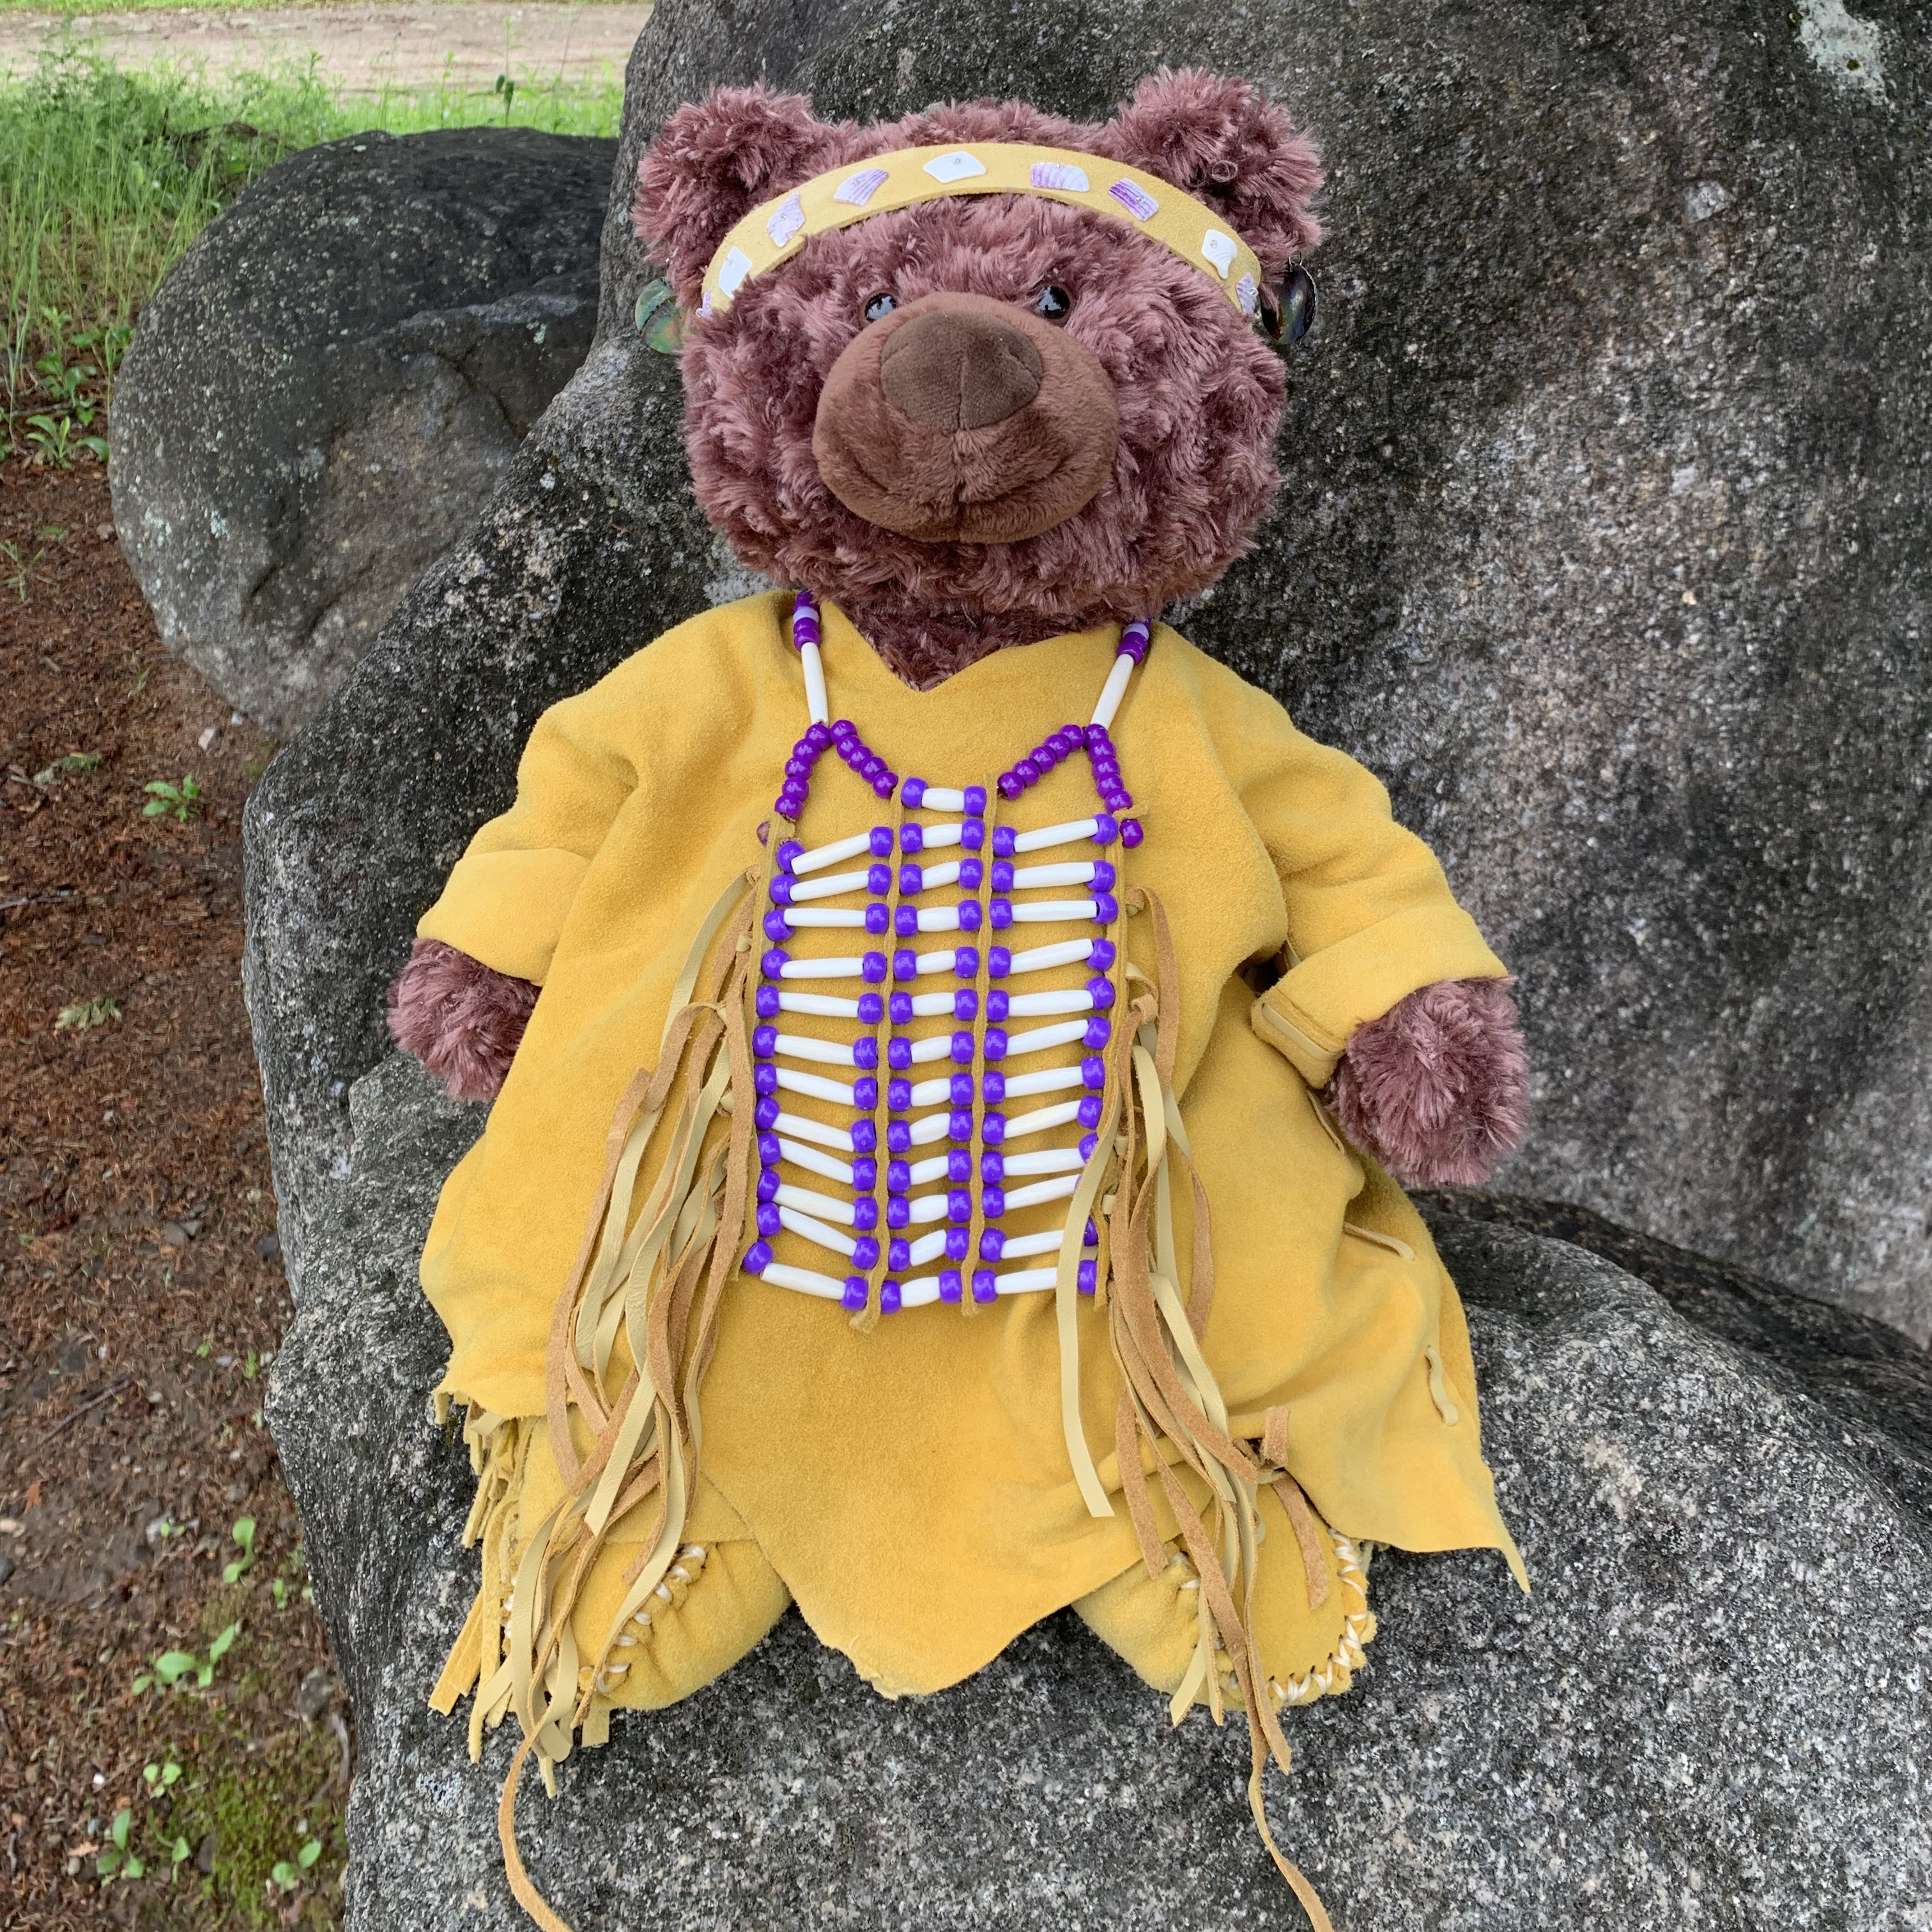
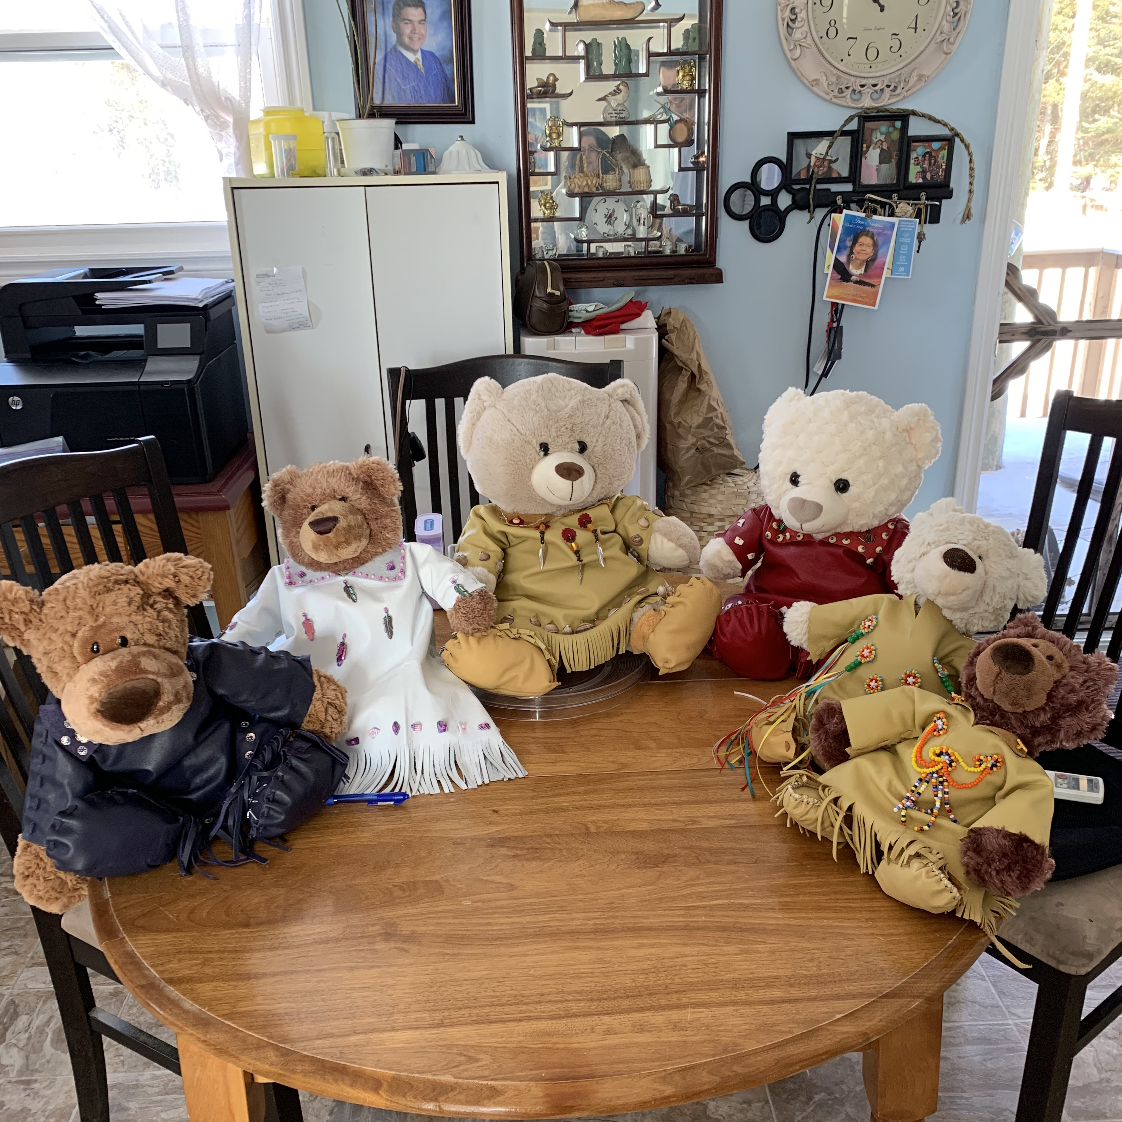
Am"bear"risters
Two Am”bear”risters have been busy visiting schools throughout ASD-N. Their aim is to help students learn about the strong, vibrant culture of Indigenous peoples and nations with a specific focus on Mi’kmaq Nations. They also help to teach our youngest students about the hardships Indigenous people face and how everyone, young and old, can be an ally. They will also be making their way to WIPCE in Adelaide Australia to present their work to educators from all over the world.
Meanwhile, after two years of work at NSEE, one patient am"bear"ister finally received his name in a traditional naming ceremony – meet Elapalin, which means Splash in Mi'kmaw.

Slide 19
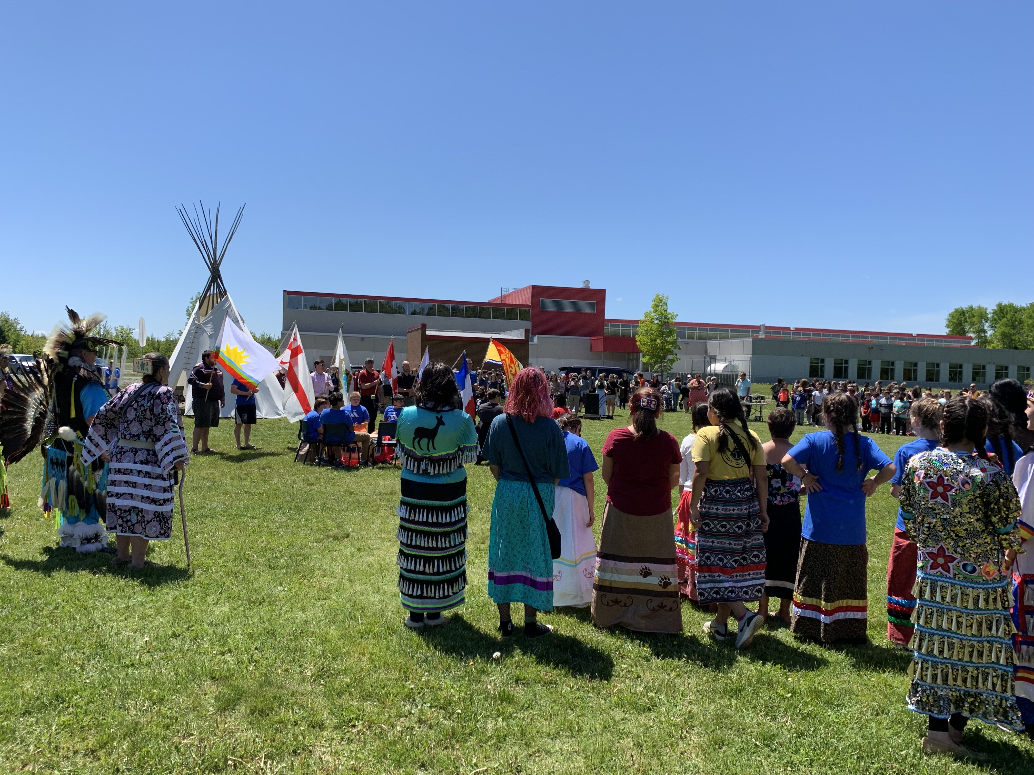
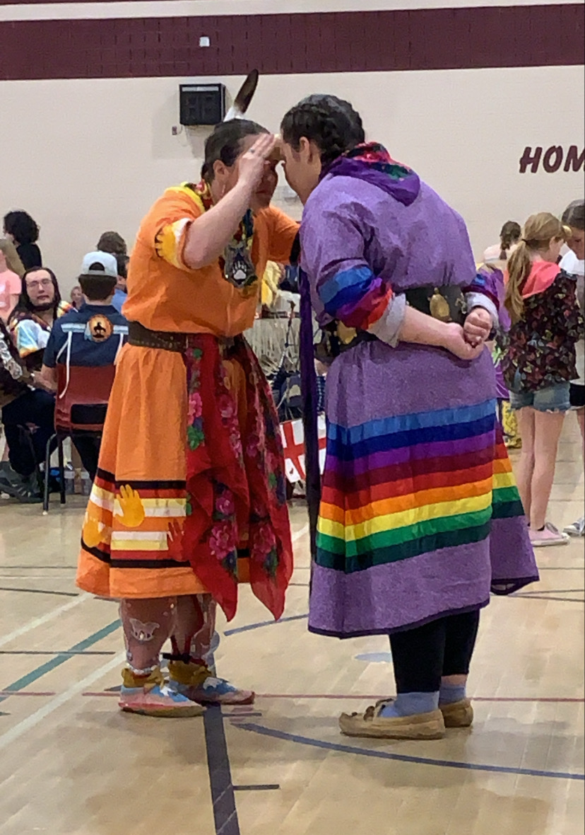
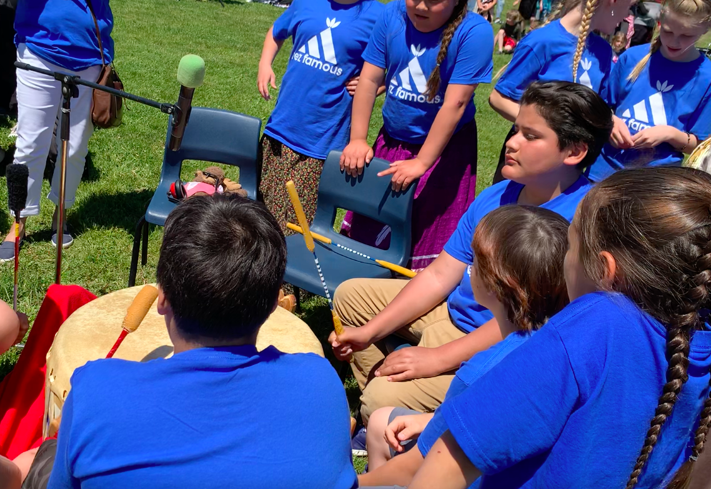
Mawi'omi's- Pow Wows
Hosted at NSER, organized by Liam Watson
Hosted at EWG, organized by Rosalie Barlow
ASD-N supported both planning committees and provided funding for drum groups

Slide 20
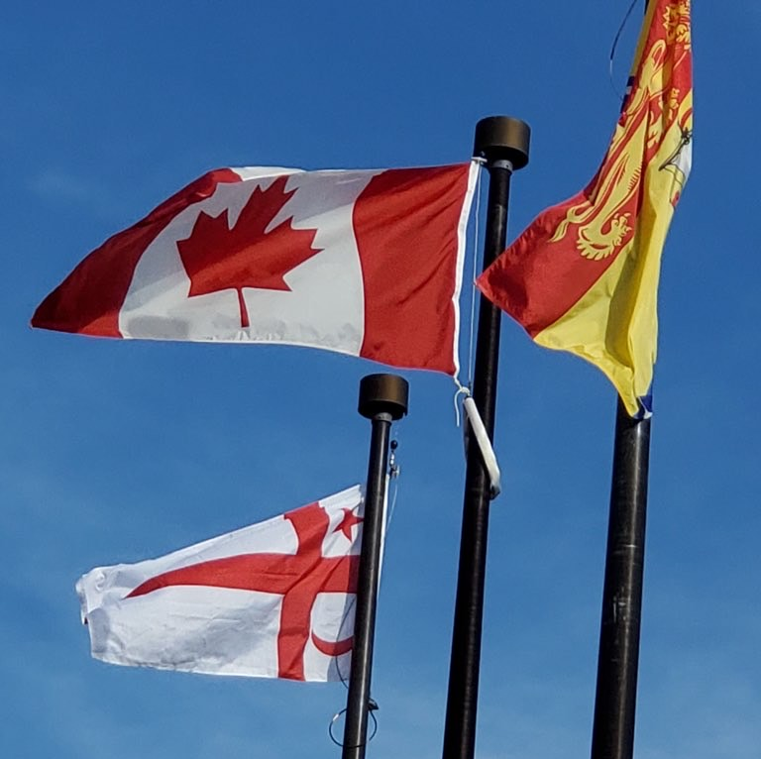
Mi'kmaq Grand Council Flags
6 schools in ASD-N have raised the MGC flag permanently
  Rexton Elementary
  Eleanor W. Graham
  Bonar Law Memorial
  Nelson Rural
  North & South Esk Regional High
  Sugarloaf Senior High School
3 more in progress
  Dalhousie Regional High School
  Millerton School
  Tabusintac School

Slide 21
Partnerships
Early Childhood
  Professional learning provided for early childhood educators
University of New Brunswick
  Seminar session provided for First Nations Education cohort
Elsipogtog School
  Provided support for educators piloting PowerPlay Young Entrepreneurs
MAWIW
  Partnered for event at Queen Elizabeth Park on National Day for Truth and Reconciliation
Community Approach to Education
Enhanced First Nation Education & Services Agreement

Slide 22
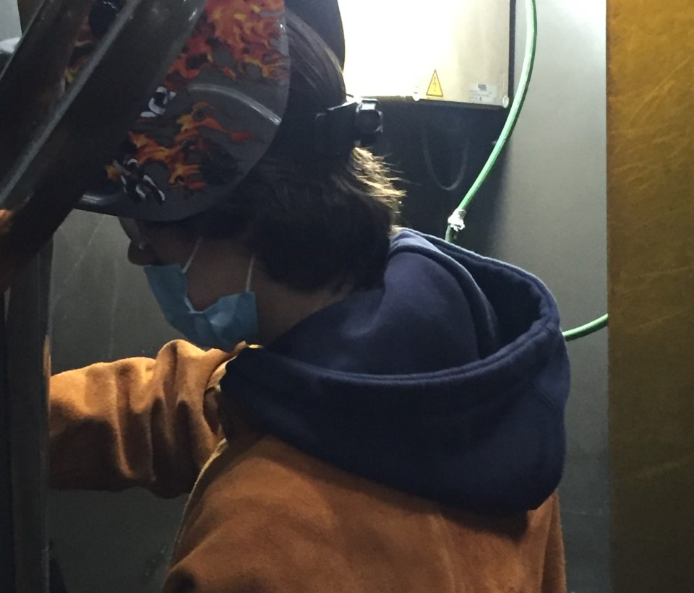
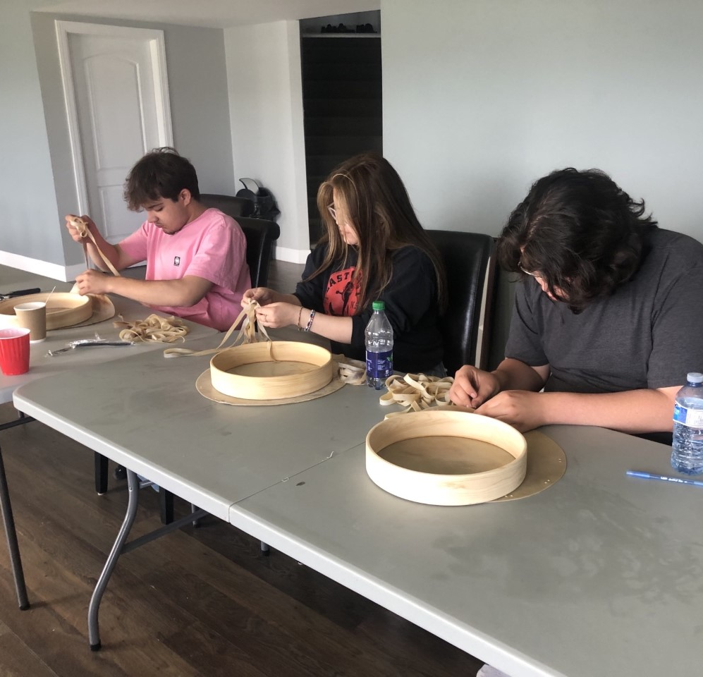
Community Approach to Education
Esgenoopetitj Site
  10 students were enrolled semester 1 for Electrical Course
  Students built a shed and warming shelter for the community rink which they helped assemble.
  Received training and certification in First Aid through St. John Ambulance
Natoaganeg Site
  8 students were enrolled semester 1 for Welding Course
  One student was successful in receiving a welding ticket from Canadian Welding Bureau.
  Utility trailer constructed for community
  Received training and certification in First Aid training through St. John Ambulance
Semester 2-
  Sites were combined and students were enrolled in Fisheries, Forestry & Community Leadership Course at the Gitpo Lodge in Natoaganeg First Nation
  Students were given leadership opportunities and completed community project

Slide 23
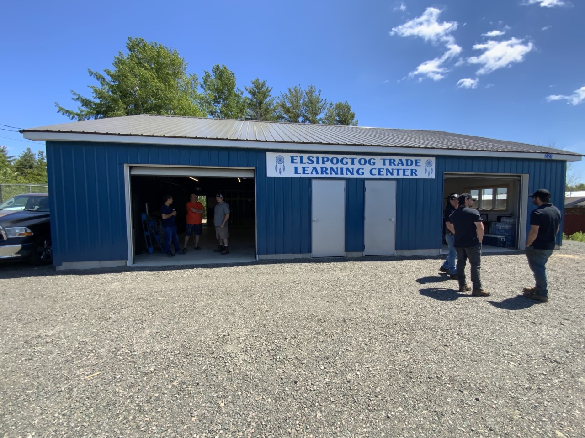
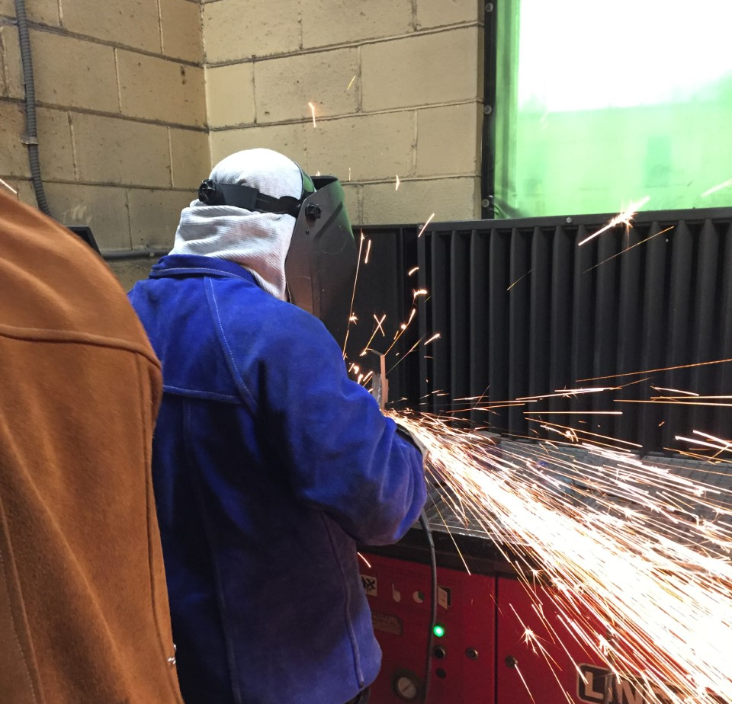
Launch in Elsipogtog
Welding Course
  Elsipogtog, ASD-N, OFNE, and BLMS launched the Community Approach to Education model for second semester
  A new facility was constructed and 10 students enrolled in the Welding Course
  Students completed community projects

Slide 24


2022-23 School Year Plans
Elsipogtog will offer Electrical Course semester 1 and Welding Course semester 2.
Natoaganeg/Esgenoopetitj will offer Welding/Electrical Course Semester 1 and Fisheries, Forestry & Community Leadership semester 2.

Slide 25

Anglophone North and First Nation
Communities
are sending 32 participants to this international conference in September.

Slide 26


Elementary (Gr. 4-5)
Tell Them From Me
Have you learned about First Nations (ex. Culture, history, traditions) in your classroom lessons in the last year?
ASD-N has observed steady growth in students learning about First Nations people in their classroom lessons each year since first recording this information in 2017-18.
Secondary (Gr. 6-12)

Slide 27

Challenges and Areas for Growth
Teachers and adminstrators have identified the need for professional learning among administrators to support First Nations Education within their schools
Funding for land-based learning and cultural activities available to all schools
Continued work is needed to embed the Elders in Schools program in curriculum and school environement
Mi'kmaw language instructors
Elders and knowledge keepers
First Nations focused ESS needs
When new social studies curricula are released, there is going to be a big need for support for teachers to embed First Nations knowledges into lessons

